Slide 1

Deep Dive with Azure Service Bus
@danielmarbach
Notes:
A warm welcome from my side. In the past few years I have been involved in writing a lot of code on top of three generations of Azure Service Bus SDKs and have even gone so far to contribute improvements and fixes to the SDK or its third party dependencies. In this talk I’m going to focus on code samples in .NET that show how to leverage the latest incarnation of the Azure Service Bus .NET SDK with focus on messaging patterns from the basics into more advanced territory like transactions, batching and more.
What I won’t cover in this talk is:
Authorization and Authentication
Alternative ways to manage Azure Service Bus namespaces such as ARM, Terraform…
Let’s do a brief overview over the Azure messaging and event fleet

Slide 2




Eventing
Messaging
Event Grid
Event Hubs
Storage Queues
Service Bus
Cross cloud reactive eventing
Big data streaming
Simple task queues
Enterprise messaging
Notes:
Very brief
Event Grid
Eventing backplane that enables event-driven reactive programming
Event consumption of Azure and Non-azure resources
The event message has the information you need to react to changes in services and applications
Event Grid isn't a data pipeline, and doesn't deliver the actual object that was updated.
Reactive programming, events are discrete facts
Event Hubs
Azure Event Hubs is a big data pipeline
For telemetry and event stream data (capture, retain and replay)
Low latency, capable of receiving and processing millions of events per second
Events are streamed in order
Azure Storage Queues
Introduced first, backed by Azure Storage
Allows to store large volumes of messages
Lightweight messages, simple durable task queues
64 KB messages
Azure Service Bus
Traditional enterprise applications that require rich messaging semantics
Reliable state transition management for business processes
Enables hybrid cloud solutions
Receive messages without polling
Richer application semantics like
FIFO
Deduplication
Transactional behavior and atomicity
Compliance with AMQP
Richer semantics like queues, topics and subscriptions, batching on send
communication backbone for many sophisticated cloud solutions
Story of bike mechanic today muttering about my bringing my bycicle for service
Before the load balancing improvement the success rate was 99.9995% (25 billion requests, 120K failed) 5 nines After the load balancing improvements in 2019 the rate is 99.99999995 % (21 billion requests, 11 failed) 9 nines!
https://twitter.com/DanRosanova/status/1135943859307995143/photo/2
Event
Lightweight notification of condition or state change
Discrete units or parts of a series (time ordered and interrelated)
Actionable, no contract between publisher and subscriber
Message
Raw data to be produced by a consumer
Contains data that triggered the pipeline
Expectations in form of a contract
Can be used together. Let’s focus on ASB for now

Slide 3
Namespace
Entities
Unit of Isolation
Notes:
Namespace represents a unit of isolation and belongs to a tier
The following tiers are available

Slide 4
Tiers
Basic
Standard
Premium
Consumption (Operation)
Resource (MsgUnit)
Notes:
Basic
Shared capacity
256 KB messages
Only queues
5 cents per million operations
Standard
Shared capacity
256 KB messages
Queues and Topics
9.81 USD per 13 million operations
Queues and Topics default 1 GB size (max 5 GB), with partitioning this can go to 80 GB with 16 partitions
Small charges after first 1k connections a month
Premium (recommended)
Dedicated capacity
1024 KB messages
Message operations unlimited
677 USD per month per messaging unit
You can purchase 1, 2, 4 or 8 messaging units for each Service Bus Premium namespace. A single workload or entity can span multiple messaging units and the number of messaging units can be changed at will.
No partitioned queues and topics but 80 GB queues and topics
No express entities
Connections included

Slide 5

Notes:
When we want to write .NET Code again Azure Service Bus we need to pull in the SDK via nuget. Let’s do that

Slide 6
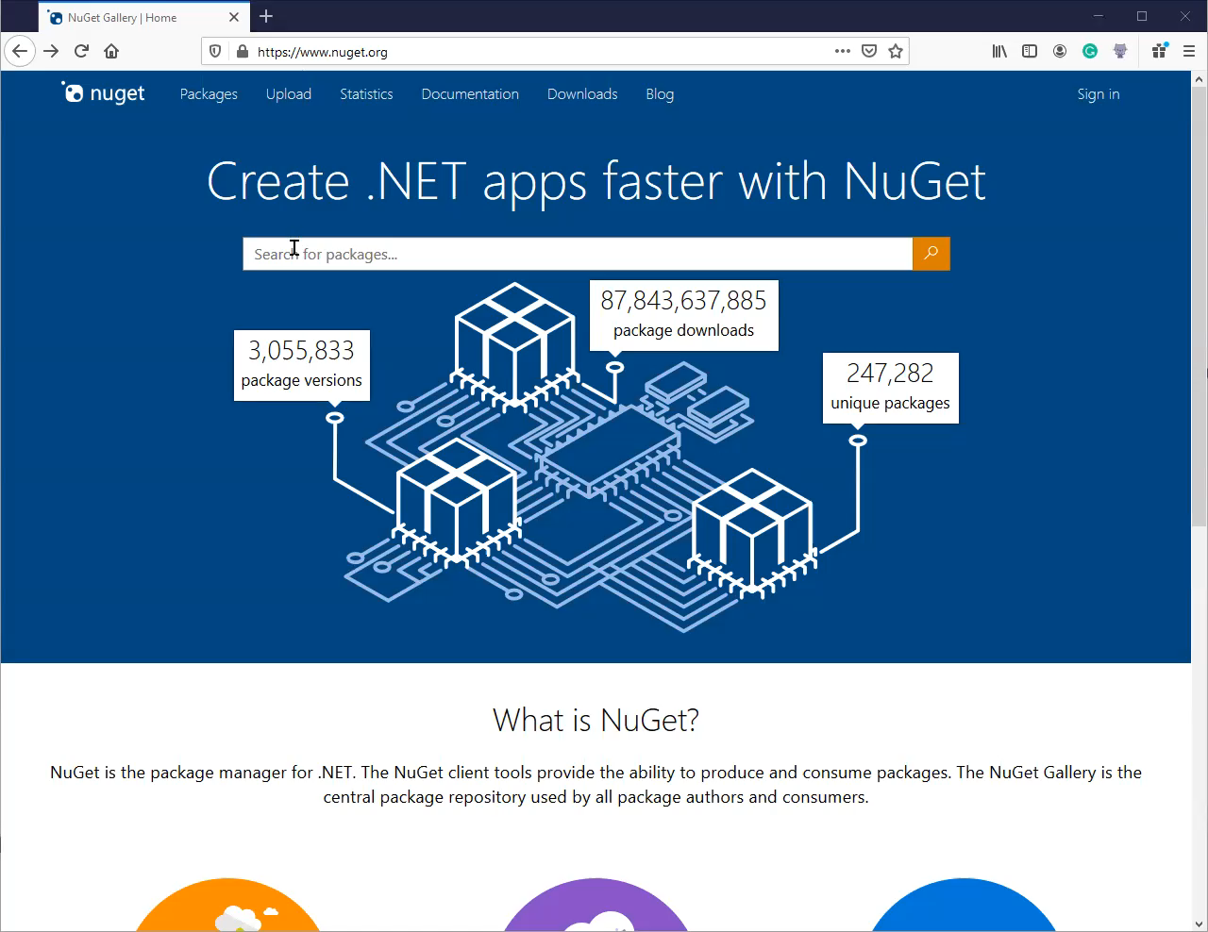
Notes:
No it’s that one, scroll down
Even further
Oh there it is!

Slide 7
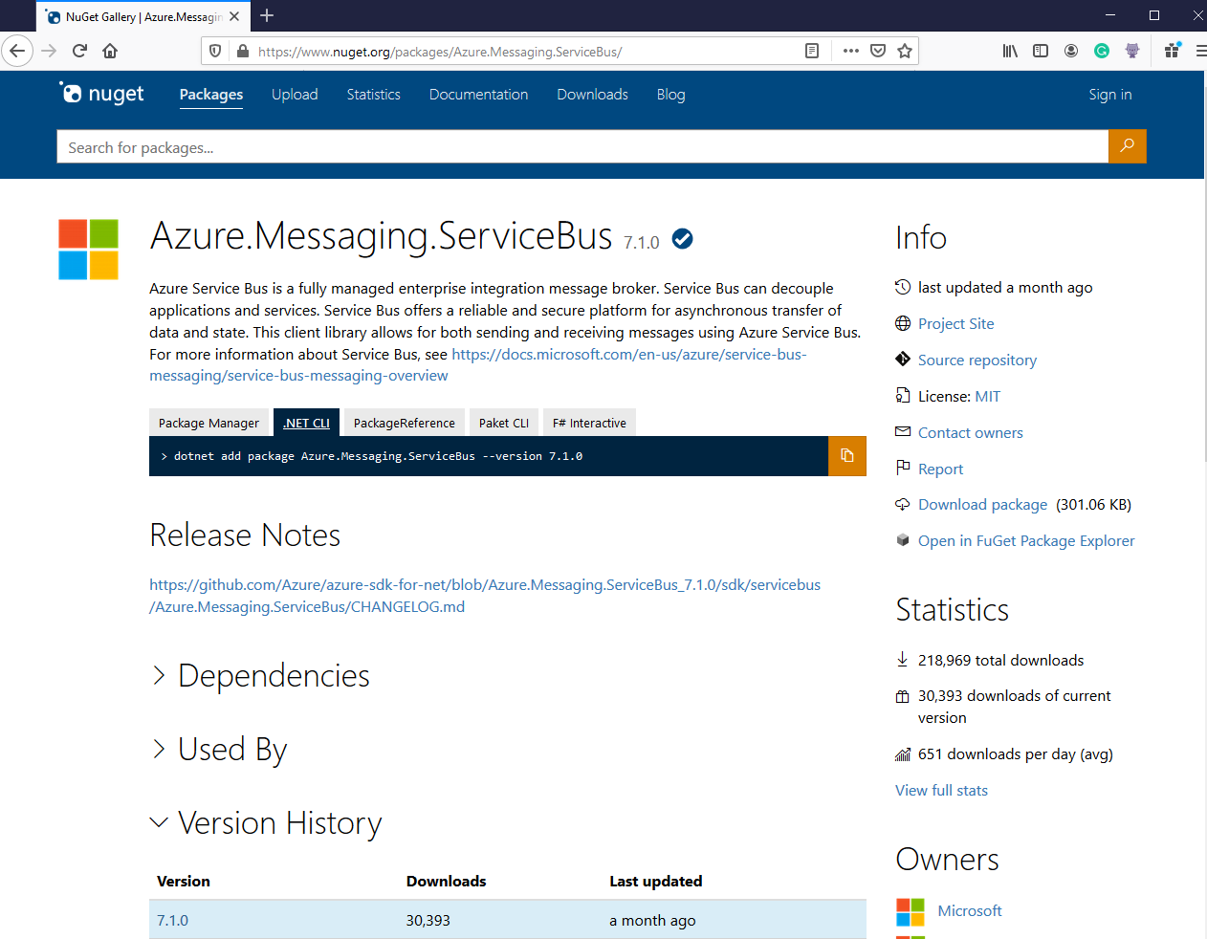

Notes:
As you can see there are multiple clients available. The service is quite mature and the client libs went through several iterations from
WindowsAzure.ServiceBus
Microsoft.Azure.ServiceBus
And finally due to recent alignment efforts across all the Azure SDKs
Azure.Messaging.ServiceBus
Use that one. It’s great. And like the node ecosystem things won’t change for the next two weeks I’m sure ;)

Slide 8
Send
Notes:
Let’s bring some messages into the broker shall we.

Slide 9
await using var serviceBusClient = new ServiceBusClient(connectionString);
await using var client = serviceBusClient.CreateSender(destination);
var message = new ServiceBusMessage("Deep Dive");
message.ApplicationProperties.Add("TenantId", "MyTenantId");
await client.SendMessageAsync(message);
<PackageReference Include="Azure.Messaging.ServiceBus" />
Notes:
ServiceBusClient is the center of gravity where things start
Using here new C# 8 await using syntax which is supported by the new client
Using here a connection string based approach for simplicity. Things like managed identity are also supported
ServiceBusMessage accepts strings and other payload types. For high perf scenarios this SDK version also supports ReadonlyMemory<byte>

Slide 10
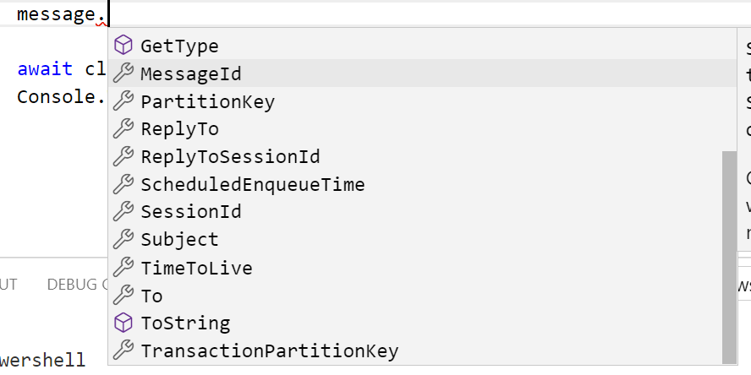

Slide 11
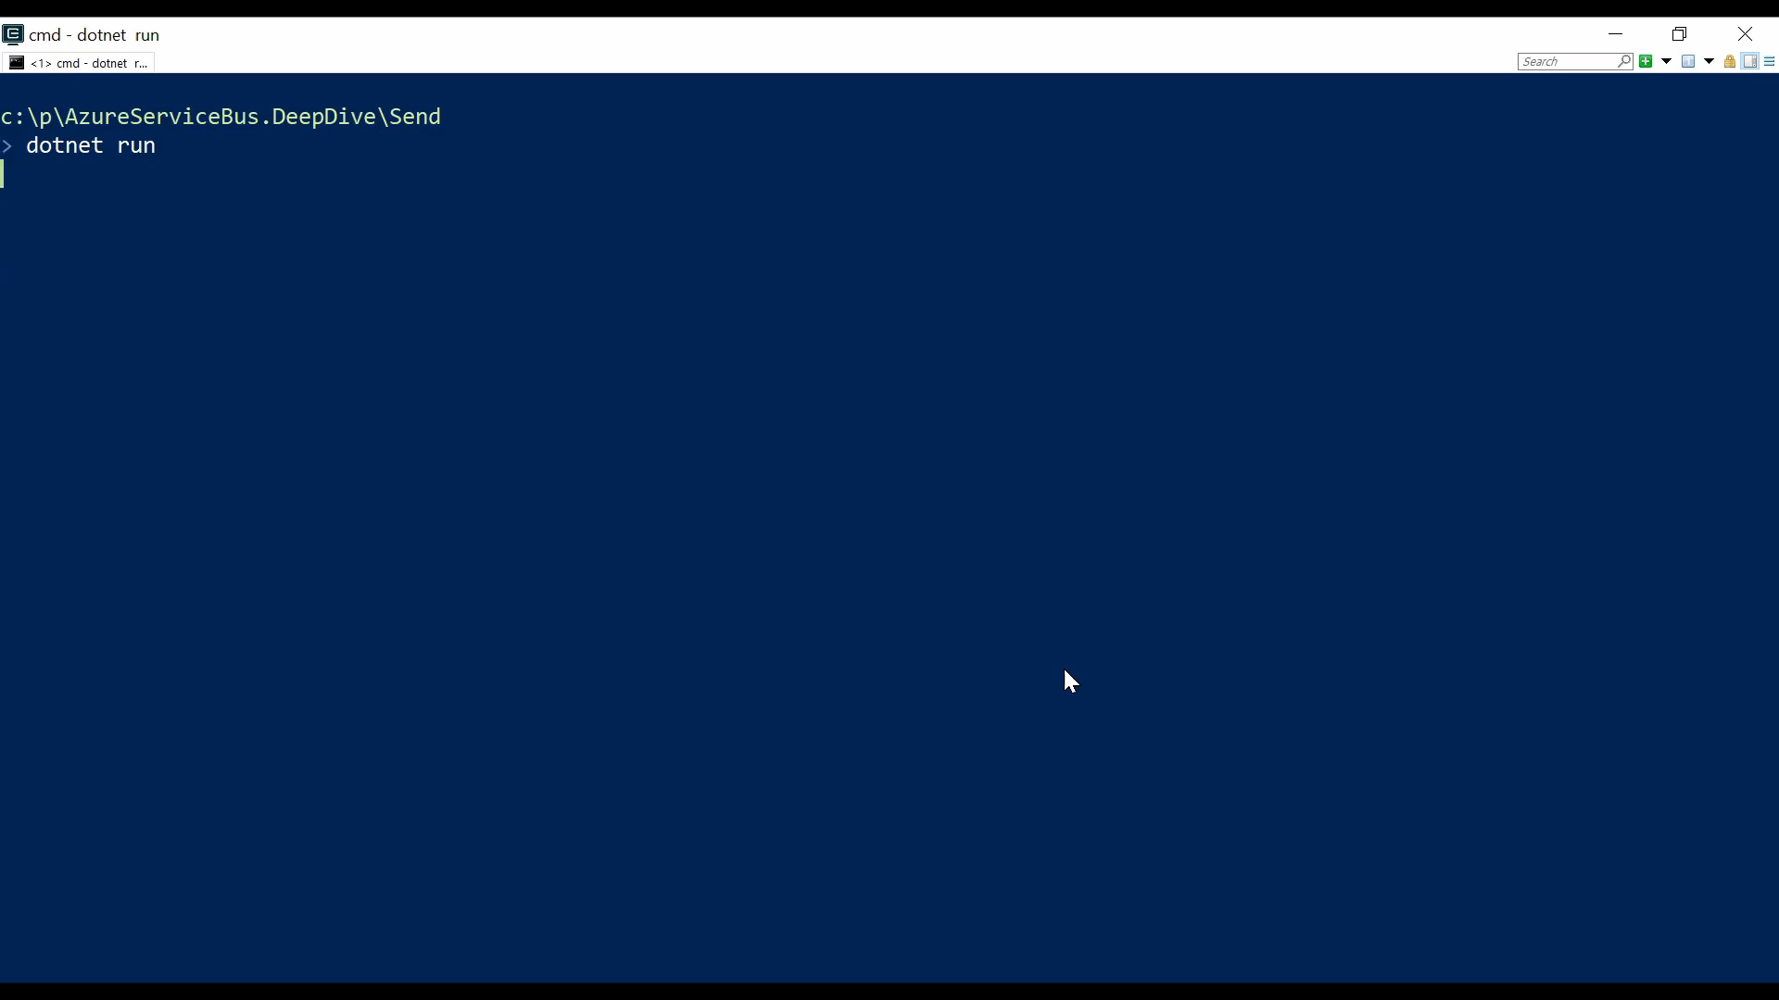
Notes:
When the code is executed we get a MessageEntityNotFoundException. Why is that? Well the queue doesn’t exist yet. Let’s create it

Slide 12
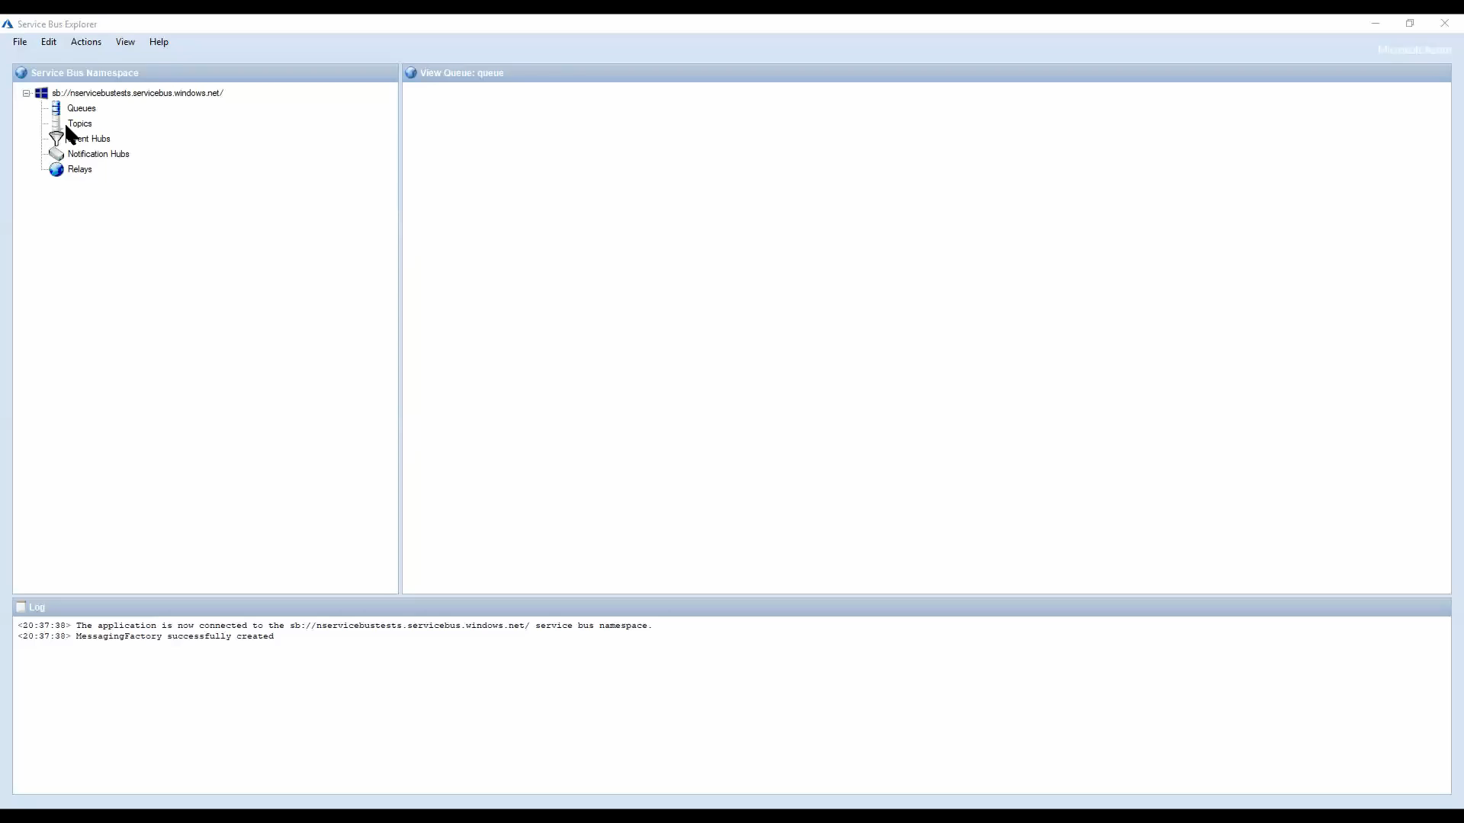
Notes:
As a first step I use Right click deploy kind of approach ☺ ServiceBusExplorer is an amazing OSS tool to see what’s going on
Now let’s run the code again

Slide 13
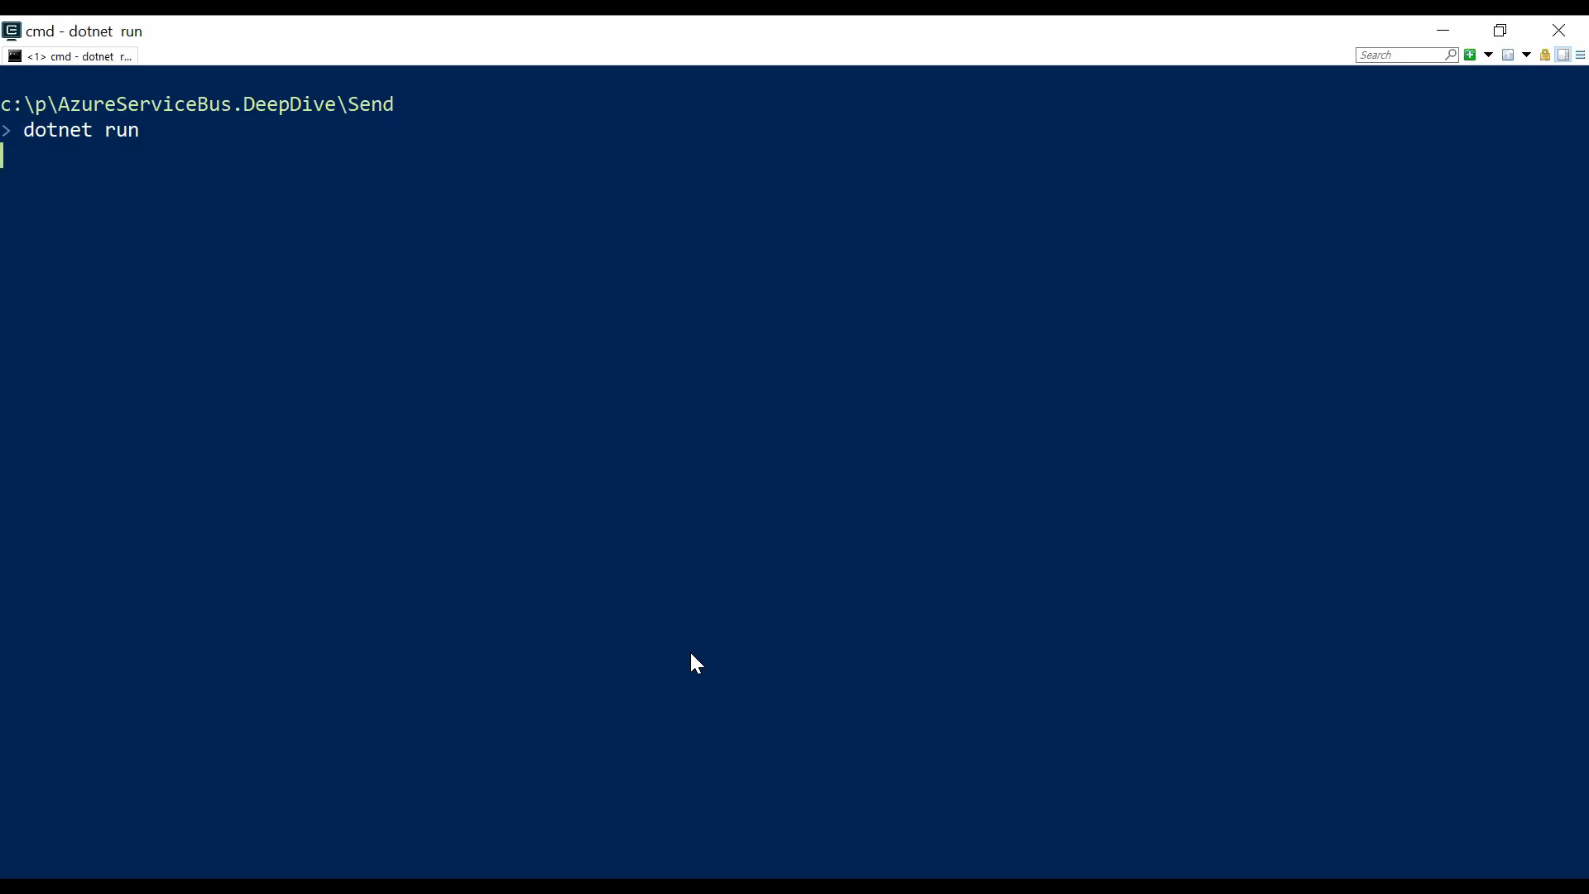
Notes:
Surprise it works. Who would have thought that ;)
Let’s check the queue again with our favorite tool

Slide 14
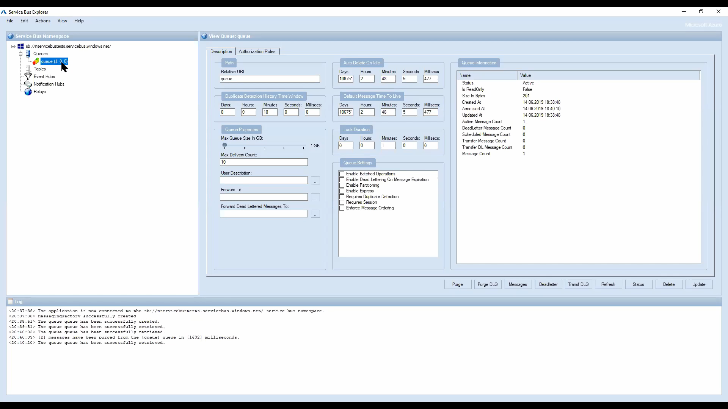
Notes:
We can see how the data we sent was properly set including the application properties
We manually created queues. What if we want to do that with code?

Slide 15
Management
Notes:
The client has built-in management capabilities. Let’s explore some of them

Slide 16
var client = new ServiceBusAdministrationClient(connectionString);
await client.CreateQueueAsync(destination);
Notes:
SerciceBusAdministrationClient is the entry point. The connection requires manage rights in order to be able to create identities.
Of course you don’t need to use this approach. You can also use Azure Resource Manager, Terraform, Pulumi or any other tool to your liking. On top of that NServiceBus for example provides a command line utility that creates entities for an NServiceBus endpoint based on NServiceBus own opinionated way of interaction with Azure Service Bus
Once a message is sent to a queue, how do we receive it again?

Slide 17
Receive
Notes:
There are essentially two major ways of receiving messages from a queue or an entity

Slide 18
await using var sender = serviceBusClient.CreateSender(destination);
await sender.SendMessageAsync(new ServiceBusMessage("Deep Dive"));
Notes:
First we need to send some messages again, brief recap how that looks like

Slide 19
var receiverOptions = new ServiceBusReceiverOptions
{
ReceiveMode = ServiceBusReceiveMode.PeekLock,
PrefetchCount = 10,
SubQueue = SubQueue.None
};
await using var receiver = serviceBusClient
.CreateReceiver(destination, receiverOptions);
await foreach (var message in receiver.ReceiveMessagesAsync())
{
// consume message
}
Notes:
In the first mode which gives us a lot of control over how we receive messages and how we handle those we manually receive messages and iterate over them. With great flexibility comes great responsibility. We have to do a lot of manual heavy lifting for things like concurrency, limiting concurrency etc.
Use the service bus processor instead

Slide 20
var processorOptions = new ServiceBusProcessorOptions
{
AutoCompleteMessages = false,
MaxConcurrentCalls = 1,
MaxAutoLockRenewalDuration = TimeSpan.FromMinutes(10),
ReceiveMode = ServiceBusReceiveMode.PeekLock,
PrefetchCount = 10
};
await using var receiver = serviceBusClient. CreateProcessor(destination, processorOptions);
Notes:
ServiceBusProcessorOptions
AutoComplete (defaults to true)
MaxConcurrentCalls (defaults to one)
MaxAutoLockRenewalDuration (defaults to 5mins)
PrefetchCount

Slide 21
receiver.ProcessMessageAsync += async messageEventArgs =>
{
var message = messageEventArgs.Message;
await Out.WriteLineAsync(
$"Received message with '{message.MessageId}’ and content '{UTF8.GetString(message.Body)}'");
// throw new InvalidOperationException();
await messageEventArgs.CompleteMessageAsync(message);
};
Notes:
Then we register an asynchronous event handler delegate

Slide 22
receiver.ProcessErrorAsync += async errorEventArgs =>
{
await Out.WriteLineAsync($"Exception:
{errorEventArgs.Exception}");
await Out.WriteLineAsync($"FullyQualifiedNamespace:
{errorEventArgs.FullyQualifiedNamespace}");
await Out.WriteLineAsync($"ErrorSource:
{errorEventArgs.ErrorSource}");
await Out.WriteLineAsync($"EntityPath:
{errorEventArgs.EntityPath}");
};
Notes:
It is also required to register an asynchronous error delegate. Otherwise the client will throw.

Slide 23
await receiver.StartProcessingAsync();
await untilStopRequired;
await receiver.StopProcessingAsync();
Notes:
It is possible to pass a cancellation token to the start and stop methods. Be aware though that the CancellationToken might not be respected when stopping due to underlying restrictions of the Microsot AMQP client (this will be worked on in the near future)
What’s the right way? If you need to process incoming messages one by one and don’t want to build message pump logic, ServiceBusProcessor is a good option.
If batching is important, manual receive might be a better option.
Let’s see it in action

Slide 24
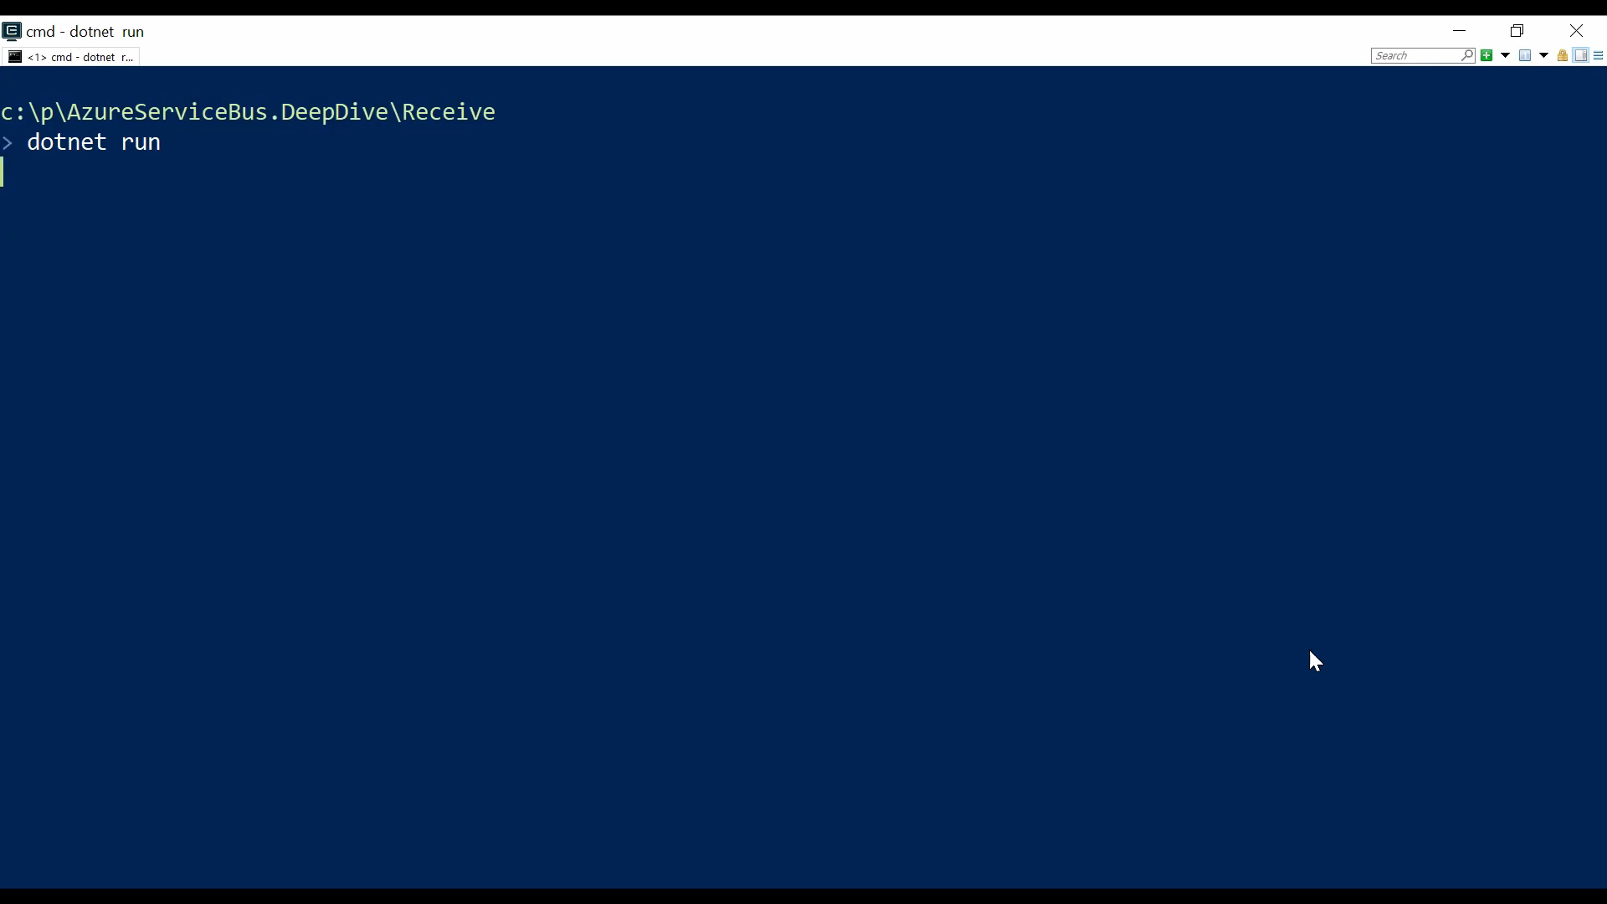

Slide 25
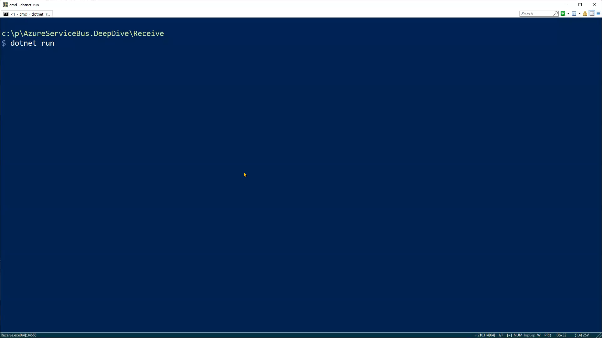
Notes:
Exception case
The message is retried multiple times until the MaxDeliveryCount is received. Messages are retried immediately. There is no exponential backoff. For delayed retries things need to be manually coded.

Slide 26
Connections
Notes:
Next up we are going to talk about connections that enable sending and receiving messages from Azure Service Bus

Slide 27
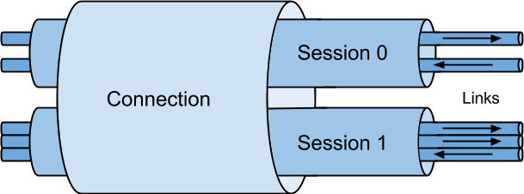
Notes:
No matter what way you’ll be connecting to the broker to send and receive messages, there’s something to keep in mind – connections
AMQP + WebSockets
On the broker side, the new client is speaking AMQP 1.0 and no more SBMP protocol.
Meaning interoperability and less constraints (number of concurrent connections: 1K vs 5K)

Slide 28
await using var serviceBusClient = new ServiceBusClient(connectionString);
await using var connectionSharingSender = serviceBusClient .CreateSender(destination);
await connectionSharingSender .SendMessageAsync(new ServiceBusMessage("Deep Dive"));
await using var connectionSharingReceiver = serviceBusClient .CreateReceiver(destination);
await connectionSharingReceiver.ReceiveMessageAsync();

Slide 29
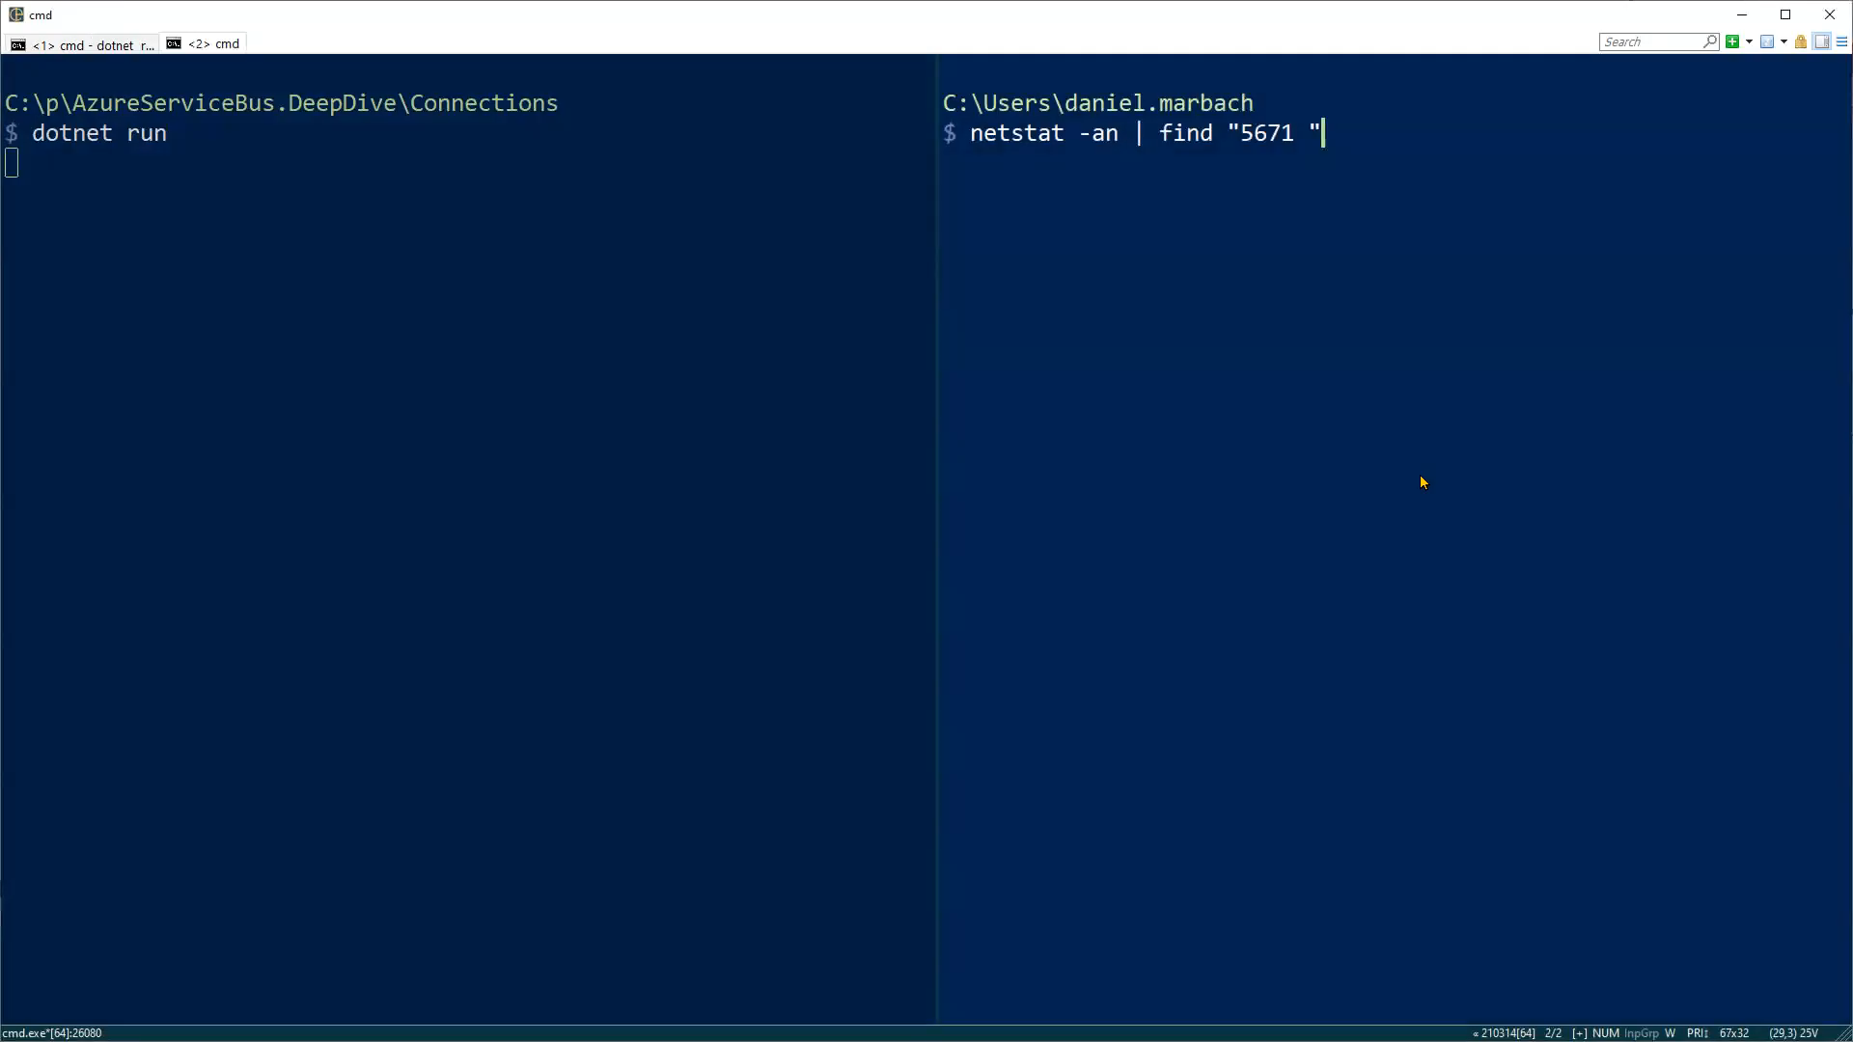

Slide 30
await using var senderServiceBusClient = new ServiceBusClient(connectionString);
await using var receiverServiceBusClient = new ServiceBusClient(connectionString);
await using var senderWithDedicatedConnection = senderServiceBusClient.CreateSender(destination);
await using var receiverWithDedicatedConnection =
receiverServiceBusClient.CreateReceiver(destination);
await senderWithDedicatedConnection .SendMessageAsync(new ServiceBusMessage("Deep Dive"));
await receiverWithDedicatedConnection.ReceiveMessageAsync();
Notes:
Change order

Slide 31
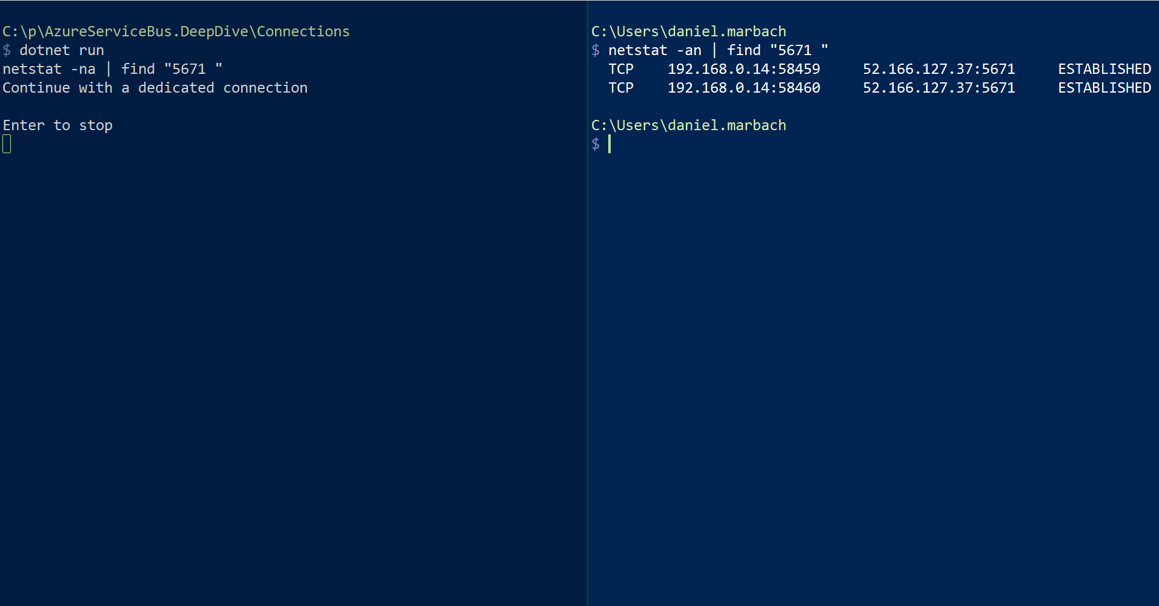

Slide 32
Scheduling
Notes:
Scheduling allows us to send messages into the future. This is a very powerful concept to implement things like delayed retries with exponential backoff or even better business domain related things like invoice reminders, buyers remorse etc.

Slide 33
await using var sender = serviceBusClient.CreateSender(destination);
var due = DateTimeOffset.UtcNow.AddSeconds(10);
await sender.ScheduleMessageAsync(
new ServiceBusMessage($"Deep Dive + {due}"), due);
Notes:
Messages scheduled are reliably stored in the input queue but not visible for consumption
As such they do not belong to the active messages when queried for during runtime.

Slide 34
var sequenceId = await sender.ScheduleMessageAsync( new ServiceBusMessage($"Deep Dive + {due}"), due);
await sender.CancelScheduledMessageAsync(sequenceId);
Notes:
With the sequence id it is possible to cancel a previously scheduled message

Slide 35
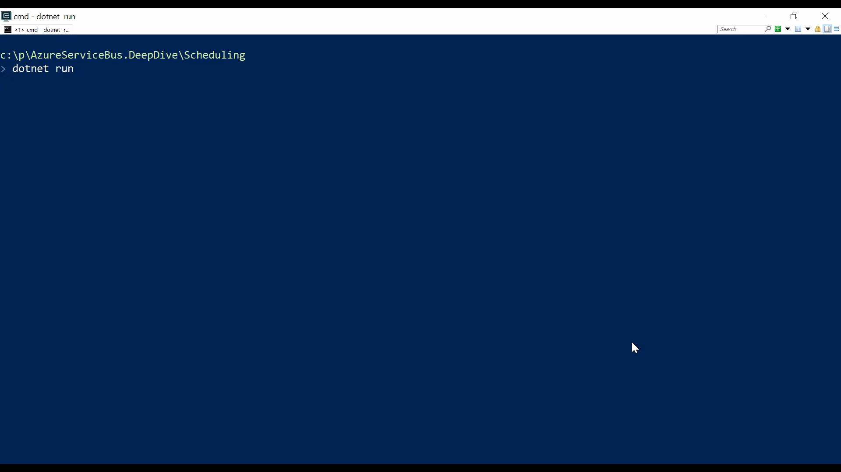

Slide 36
Expiry
Notes:
If messages need to be marked as short lived it is possible to give it a TimeToLive. TimeToLive can be set on the message or on the entity. Setting a longer TTL on the message than on the entity adjusts the TTL to the entity TTL.
This is especially handy for information that only has a short validity period. As such when the expiry kicks in the messages will not even actively use consumption time at the receivers but immediately be discarded by Azure Service Bus itself.

Slide 37
await using var sender = serviceBusClient.CreateSender(destination);
var message = new ServiceBusMessage("Half life")
{
TimeToLive = TimeSpan.FromSeconds(10)
};
await sender.SendMessageAsync(message);
await Prepare.SimulateActiveReceiver(serviceBusClient, destination);
Notes:
Expired messages are only purged when there is at least one active receiver pulling from the main queue or subscription, that behavior is by design
// if not set the default time to live on the queue counts

Slide 38
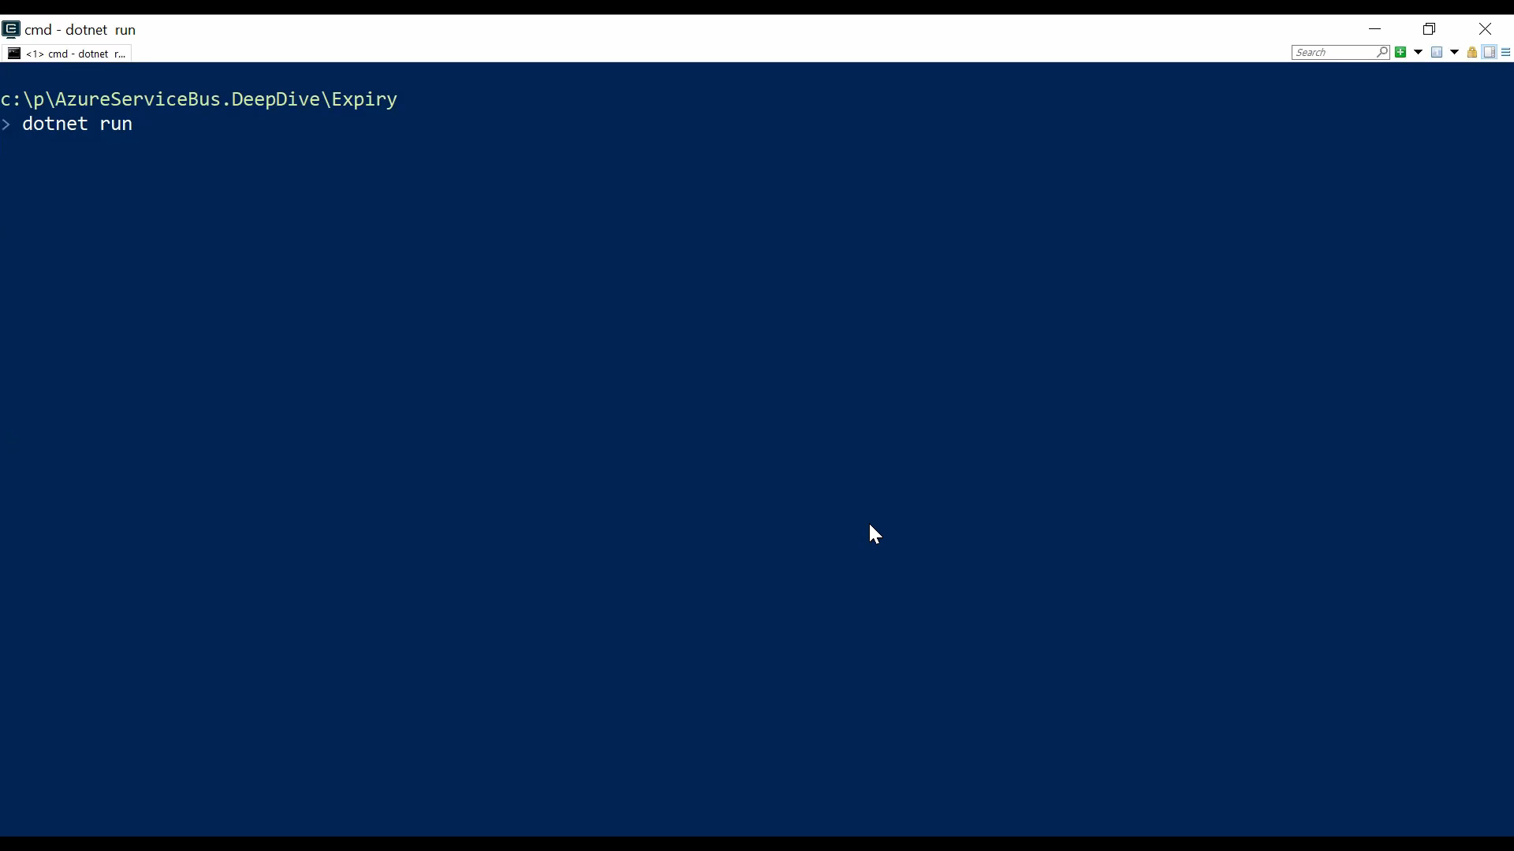
Notes:
Most boring demo ever ™

Slide 39
Where does the message go?
Notes:
But where is the message when it was expired
Let’s check with Service Bus Explorer

Slide 40
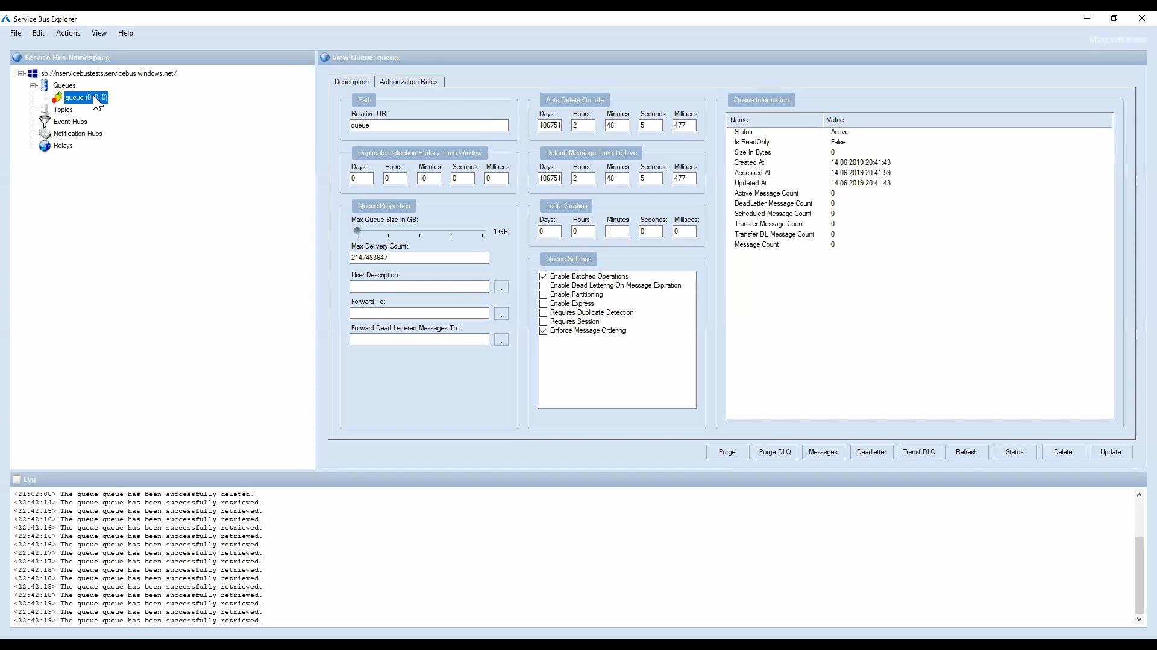
Notes:
By default messages will be discarded that exceeded the time to live. It is possible to set CreateQueueOptions.DeadLetteringOnMessageExpiration or CreateSubscriptionOptions.DeadLetteringOnMessageExpiration and then they will be deadlettered

Slide 41
Deadlettering
Notes:
Reasons for deadlettering
Exceeded TimeToLive
Exceeded MaxDeliveryCount
Errors while processing subscription rules when CreateSubscriptionOptions.DeadLetteringOnFilterEvaluationExceptions is set
In Forwarding or SendVia scenarios which we’ll talk about later
Every queue has essentially 4 queues (maybe you remember the SubQueue enum I showed in the beginning)
queue
queue/$DeadLetterQueue
queue/$Transfer
queue/$Transfer/$DeadLetterQueue

Slide 42
var description = new CreateQueueOptions(destination)
{
DeadLetteringOnMessageExpiration = true, MaxDeliveryCount = 1
};
await client.CreateQueueAsync(description);

Slide 43
var message = new ServiceBusMessage("Half life")
{
TimeToLive = TimeSpan.FromSeconds(1)
};
await sender.SendMessageAsync(message);

Slide 44
var message = new ServiceBusMessage("Delivery Count");
await sender.SendMessageAsync(message);

Slide 45
var message = new ServiceBusMessage("Poor Soul");
message.ApplicationProperties.Add("Yehaa", "Why so happy?");
await sender.SendMessageAsync(message);

Slide 46
receiver.ProcessMessageAsync += async processMessageEventArgs =>
{
var message = processMessageEventArgs.Message;
switch (UTF8.GetString(message.Body)) {
case "Half life":
await processMessageEventArgs.AbandonMessageAsync(message);
await Error.WriteLineAsync("Abandon half life message");
break;
case "Delivery Count":
await Error.WriteLineAsync("Throwing delivery count message");
throw new InvalidOperationException();
case "Poor Soul":
await Error.WriteLineAsync("Dead letter poor soul message");
await processMessageEventArgs.DeadLetterMessageAsync(message,
new Dictionary<string, object>
{
{"Reason", "Because we can!"},
{"When", DateTimeOffset.UtcNow}
});
break;
}
};

Slide 47
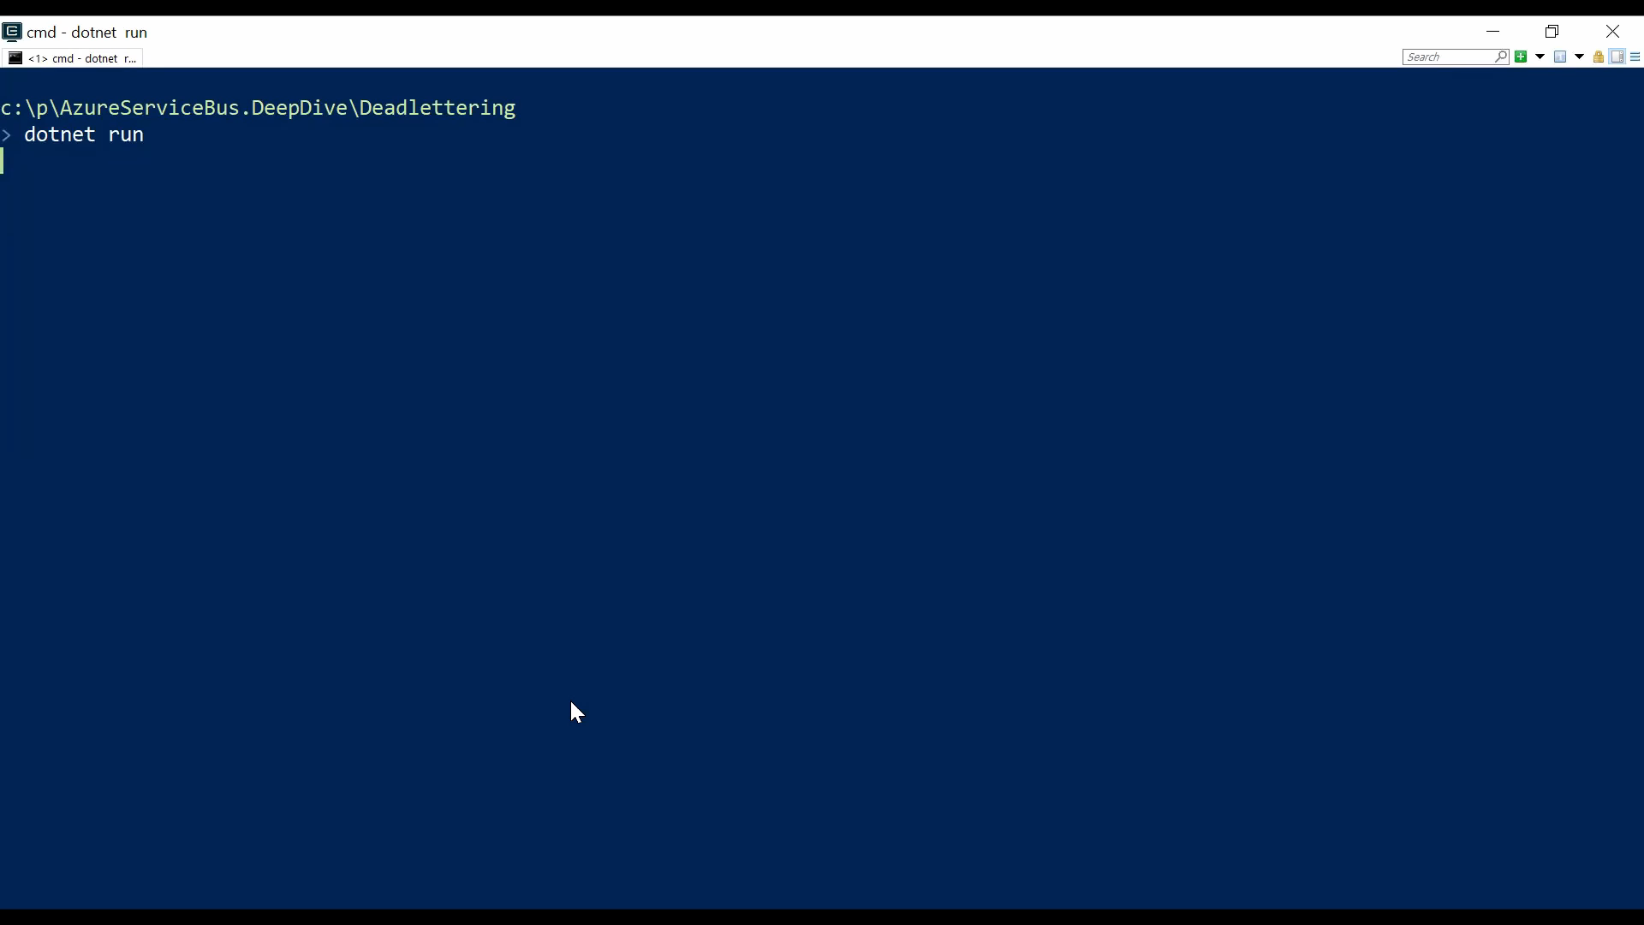

Slide 48
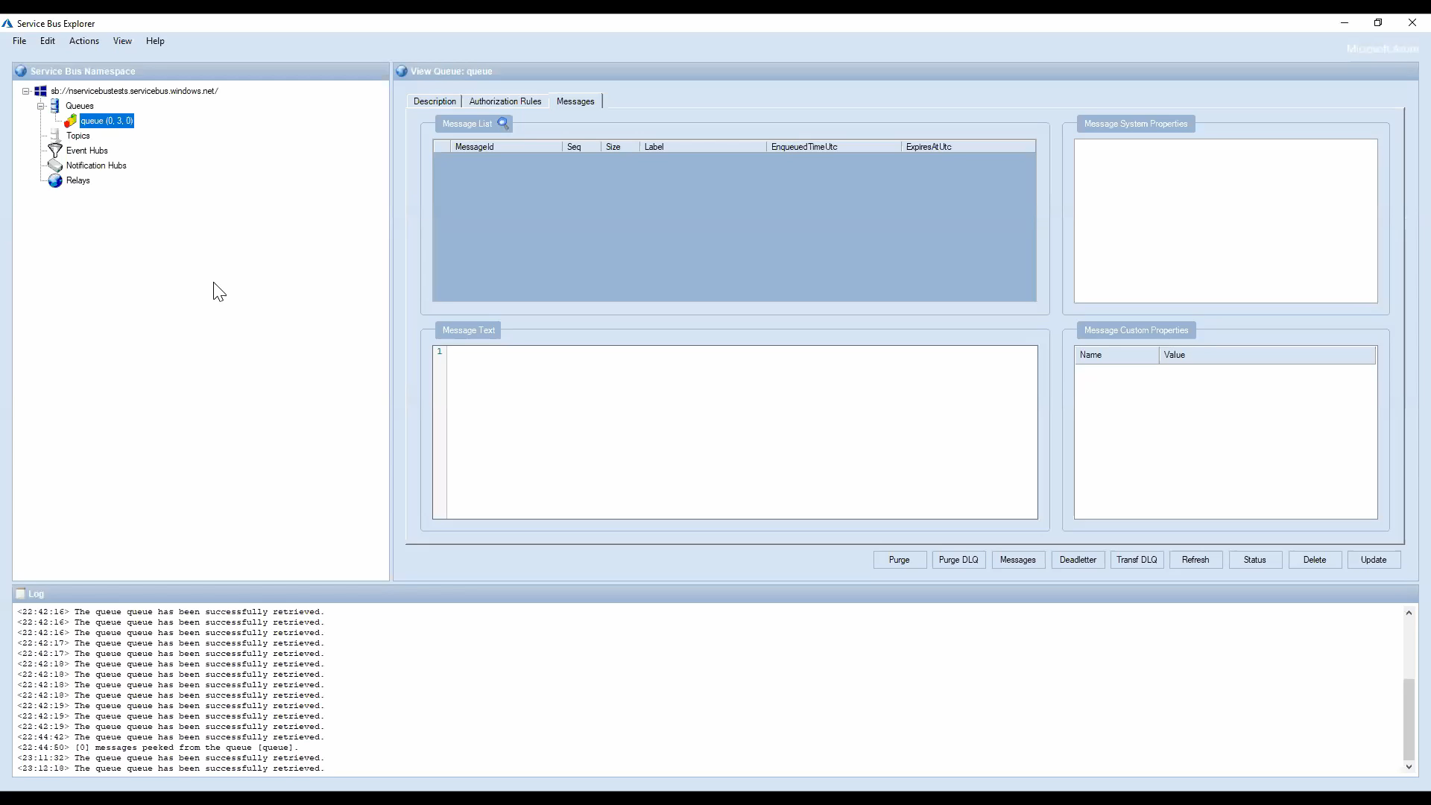
Notes:
Notice the counter in the middle represents the deadletter count

Slide 49
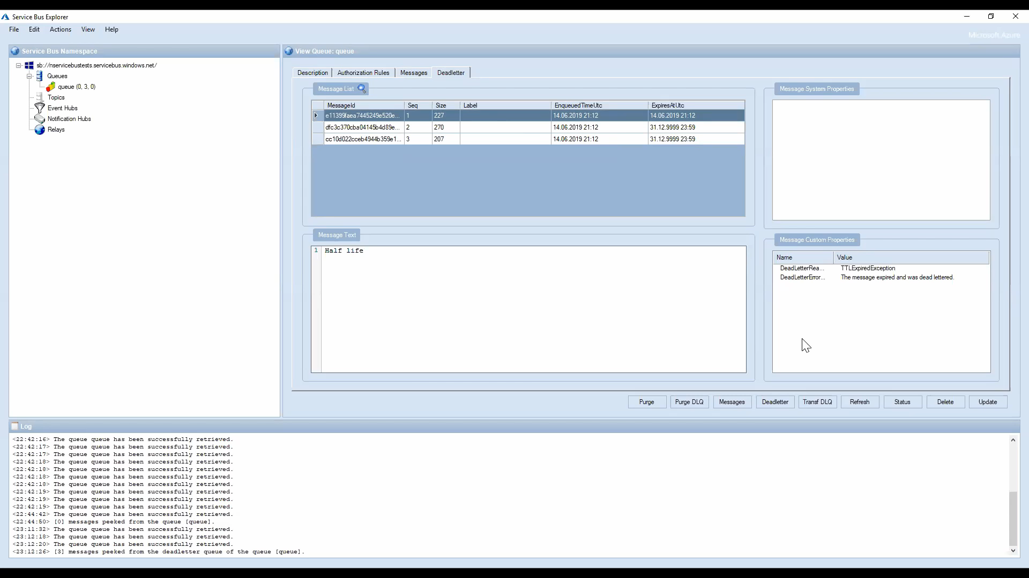

Slide 50


Slide 51
Forwarding
Notes:
Forwarding is a concept that allows entities to be connected together and act as forwarding entities, so themselves are not really managing messages anymore but forward all messages under certain conditions to the next entity.
Messages will be sent to the transfer dead-letter queue under the following conditions:
- A message passes through more than 4 queues or topics that are chained together.
- The destination queue or topic is disabled or deleted.
The destination queue or topic exceeds the maximum entity size.
Very powerful in combination with subscriptions to build hierarchies.
Service Bus bills one operation for each forwarded message.

Slide 52
Hop4
Hop3
Hop2
ForwardTo
Hop1
Hop0
Hop

Slide 53
var description = new CreateQueueOptions("Hop");
await client.CreateQueueAsync(description);
description = new CreateQueueOptions("Hop0");
await client.CreateQueueAsync(description);
description = new CreateQueueOptions("Hop1")
{
ForwardTo = "Hop0"
};
await client.CreateQueueAsync(description);
description = new CreateQueueOptions("Hop2")
{
ForwardTo = "Hop1"
};
await client.CreateQueueAsync(description);
description = new CreateQueueOptions("Hop3")
{
ForwardTo = "Hop2"
};
await client.CreateQueueAsync(description);
description = new CreateQueueOptions("Hop4")
{
ForwardTo = "Hop3"
};
await client.CreateQueueAsync(description);

Slide 54
await using var serviceBusClient = new ServiceBusClient(connectionString);
var sender = serviceBusClient.CreateSender("Hop4");
var message = new ServiceBusMessage("Weeeeeeehhh!");
await sender.SendMessageAsync(message);
Notes:
Let’s send a message to hop4

Slide 55
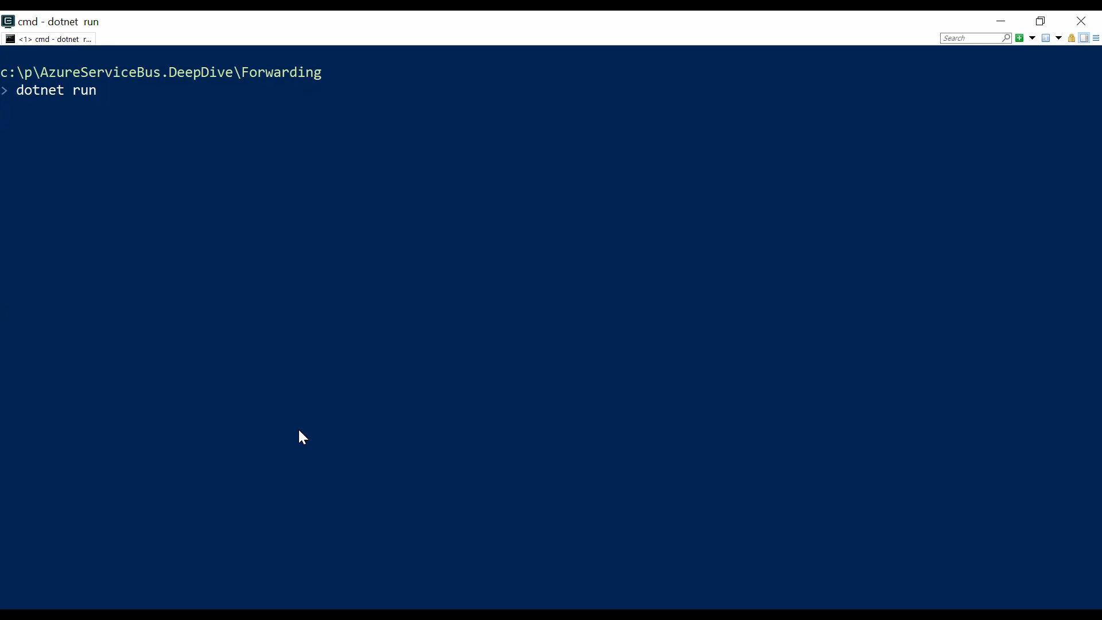

Slide 56
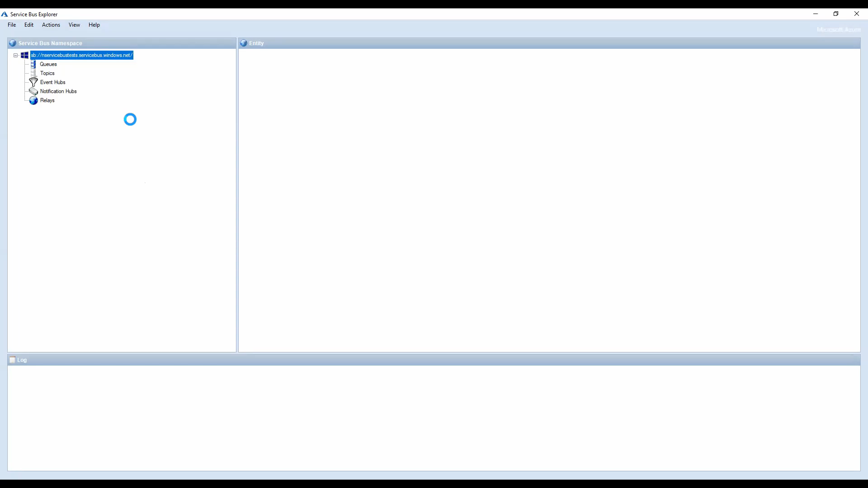
Notes:
The message was successfully consumed
Let’s setup forwarding from Hop0 to Hop

Slide 57
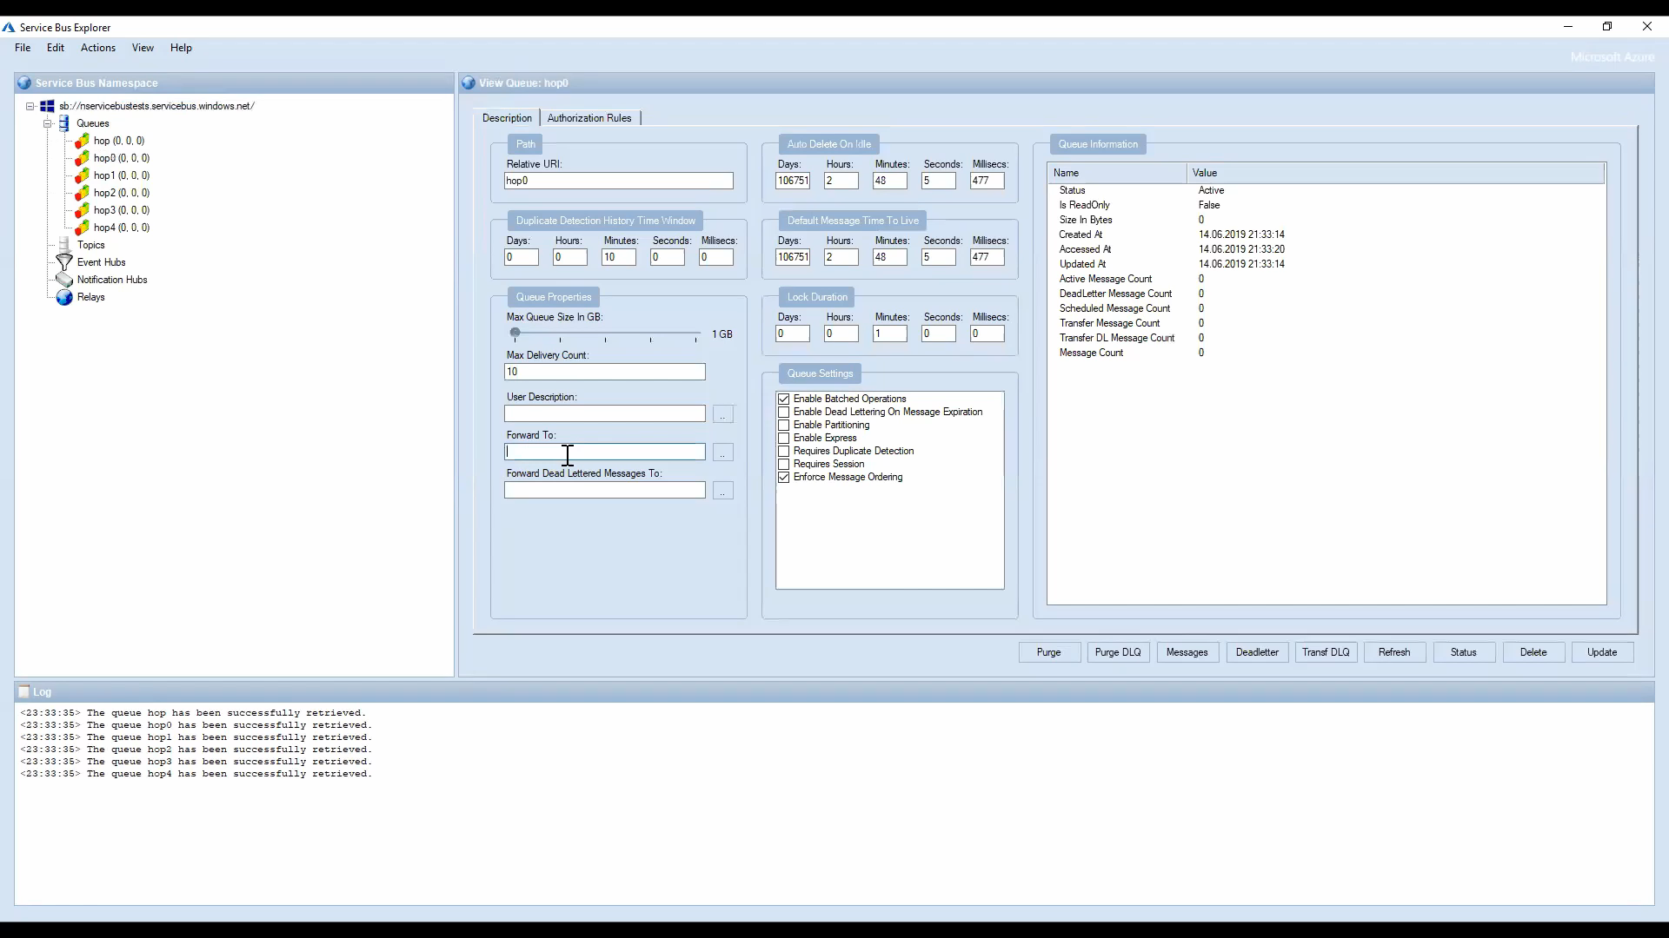

Slide 58
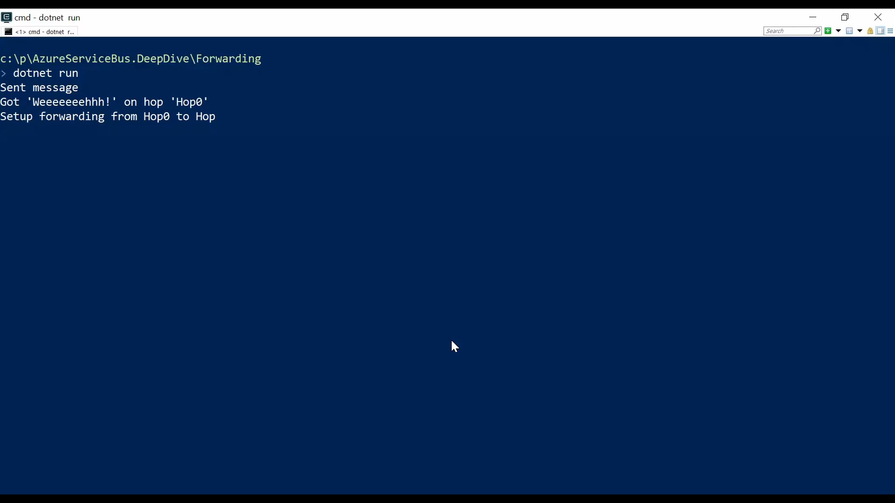
Notes:
Now it is no longer possible to receive messages from Hop0 since it has become a forwarding only entity

Slide 59
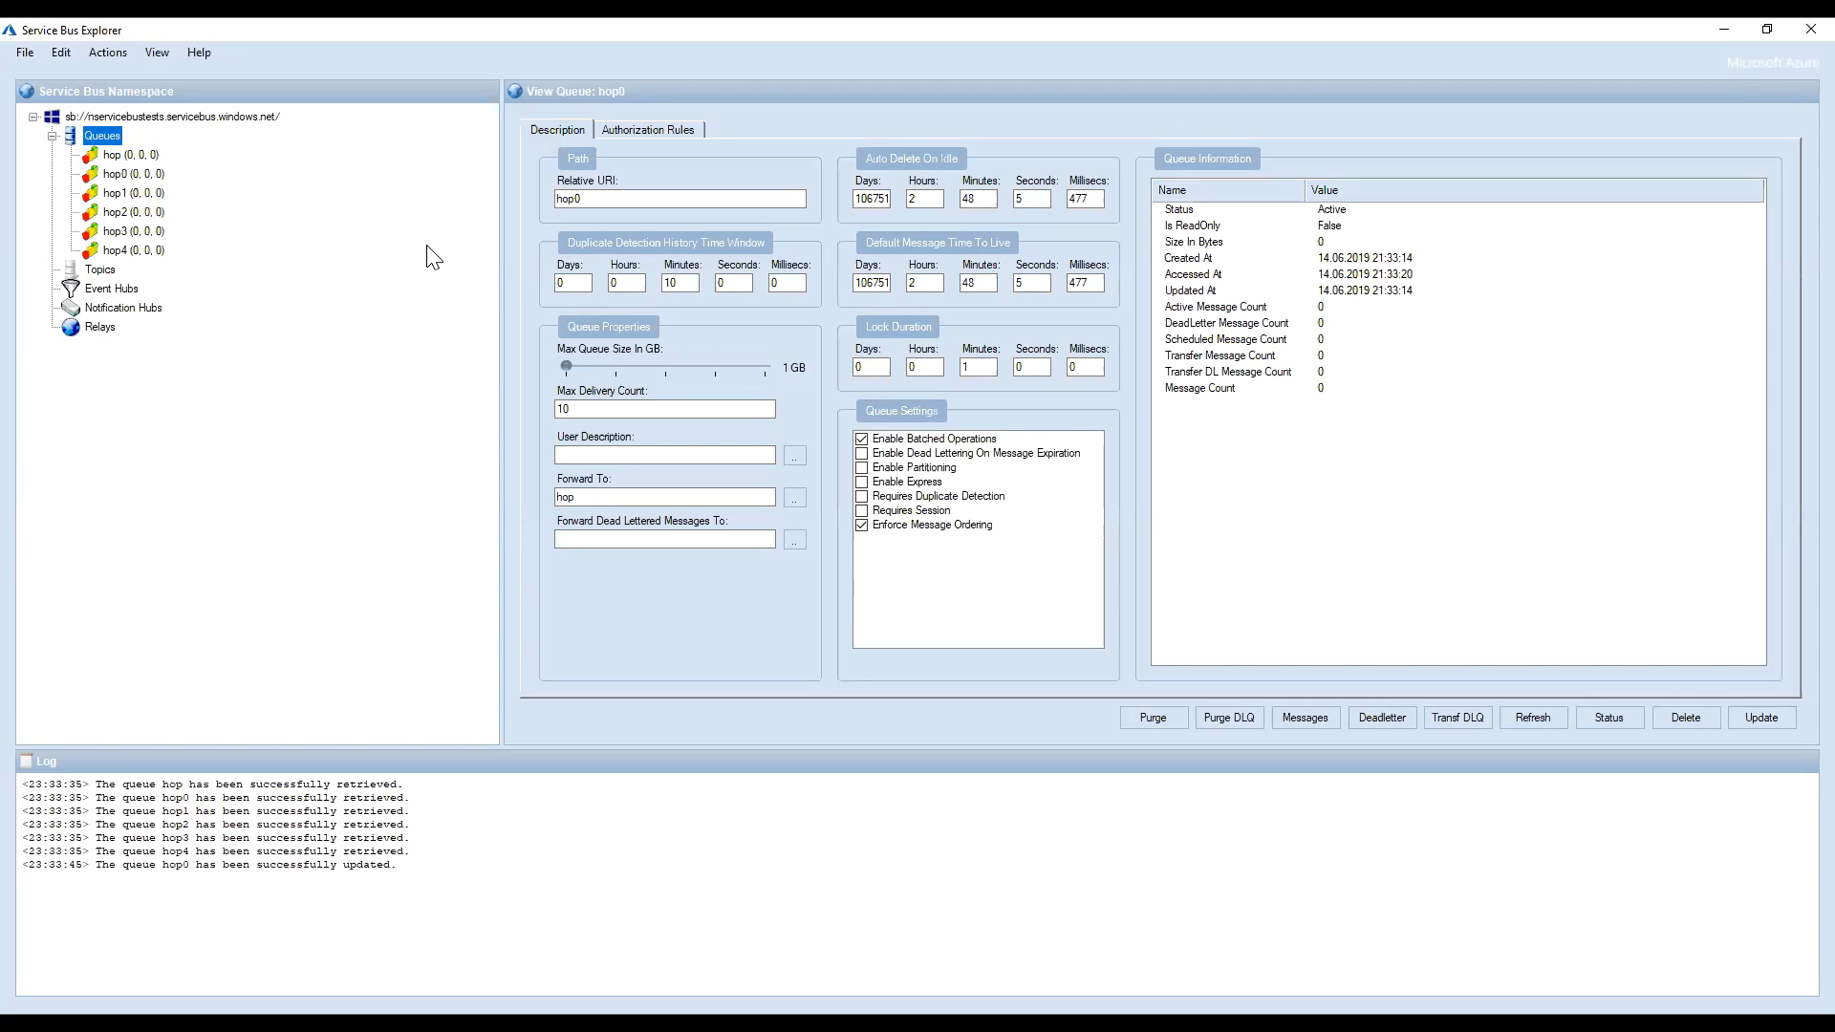
Notes:
The message now landed in the DLQ of Hop 0 because it has reached the maximum amount of hops a message is allowed to travel, remember that number is 4 hops. Fun fact, we built for NServiceBus a topology that allowed existing customers to seamlessly migrate from a previously topology to a forwarding enabled topology (which I explain in more depth later) and we relied on the max hop count being four but it turned out Azure Service Bus had a bug in the implementation (not in the client, in the service) and the team ended up rolling out a global wide change over Christmas period for us :D (thanks to Sean Feldman’s magical arm twisting capabilities ;))

Slide 60
Pub/Sub
Notes:
In contrast to queues, in which each message is processed by a single consumer, topics and subscriptions provide a one-to-many form of communication, in a publish/subscribe pattern. Useful for scaling to large numbers of recipients, each published message is made available to each subscription registered with the topic.
Senders only knows Topics
Receivers only know about Subscriptions
Subscriptions have Filters (rules) and Actions
Rules evaluated using OR (SQL) or AND (Correlation) logic

Slide 61
Sender
topic
Rule
Rule
Subscription1
Subscription2
Notes:
Messages are sent to a topic and delivered to one or more associated subscriptions, depending on filter rules that can be set on a per-subscription basis. The subscriptions can use additional filters to restrict the messages that they want to receive. Messages are sent to a topic in the same way they are sent to a queue, but messages are not received from the topic directly. Instead, they are received from subscriptions. A topic subscription resembles a virtual queue that receives copies of the messages that are sent to the topic. Messages are received from a subscription identically to the way they are received from a queue.

Slide 62
Boolean Filter
Rule
SQL Filter
Filter
Correlation Filter
Action
Notes:
Boolean filters - The TrueFilter and FalseFilter either cause all arriving messages (true) or none of the arriving messages (false) to be selected for the subscription.
SQL Filters - A SqlFilter holds a SQL-like conditional expression that is evaluated in the broker against the arriving messages' user-defined properties and system properties. All system properties must be prefixed with sys. in the conditional expression. The SQL-language subset for filter conditions tests for the existence of properties (EXISTS), as well as for null-values (IS NULL), logical NOT/AND/OR, relational operators, simple numeric arithmetic, and simple text pattern matching with LIKE.
Correlation Filters - A CorrelationFilter holds a set of conditions that are matched against one or more of an arriving message's user and system properties. A common use is to match against the CorrelationId property, but the application can also choose to match against ContentType, Subject, MessageId, ReplyTo, ReplyToSessionId, SessionId, To, and any user-defined properties. A match exists when an arriving message's value for a property is equal to the value specified in the correlation filter. For string expressions, the comparison is case-sensitive. When specifying multiple match properties, the filter combines them as a logical AND condition, meaning for the filter to match, all conditions must match.
Actions: With SQL filter conditions, you can define an action that can annotate the message by adding, removing, or replacing properties and their values. The action uses a SQL-like expression that loosely leans on the SQL UPDATE statement syntax. The action is performed on the message after it has been matched and before the message is selected into the subscription. The changes to the message properties are private to the message copied into the subscription.

Slide 63
var topicDescription = new CreateTopicOptions (topicName);
await client.CreateTopicAsync(topicDescription);
var subscriptionDescription = new CreateSubscriptionOptions(topicName, rushSubscription);
await client.CreateSubscriptionAsync(subscriptionDescription);
subscriptionDescription = new CreateSubscriptionOptions(topicName, currencySubscription);
await client.CreateSubscriptionAsync(subscriptionDescription);

Slide 64
var ruleDescription = new CreateRuleOptions
{
Name = "MessagesWithRushlabel",
Filter = new CorrelationRuleFilter
{
Subject = "rush"
},
Action = null
};
await client. CreateRuleAsync(topicName, rushSubscription, ruleDescription);

Slide 65
ruleDescription = new CreateRuleOptions
{
Name = "MessagesWithCurrencyCHF",
Filter = new SqlRuleFilter("currency = 'CHF'"),
Action = new SqlRuleAction("SET currency = 'Złoty'")
};
await client.CreateRuleAsync(topicName, currencySubscription, ruleDescription);
Notes:
To tease my polish colleagues I’m going to degrade swiss francs to Zloty (guess which is the more powerful currency ;) )
(Swiss national bank decoupled in 2015 the swiss franc from the euro which creates a huge currency market disaster, some polish people had deposited saving in Swiss banks in swiss francs…). Now a few years later we can laugh about this but at time that wasn’t fun. I was actually also affected. On one day I lost 30% of my yearly income due to the CHF to USD drop, just like that.

Slide 66
var message = new ServiceBusMessage("Damn I have no time!")
{
Subject = "rush"
};
await sender.SendMessageAsync(message);
message = new ServiceBusMessage("I'm rich! I have 1000");
message.ApplicationProperties.Add("currency", "CHF");
await sender.SendMessageAsync(message);

Slide 67
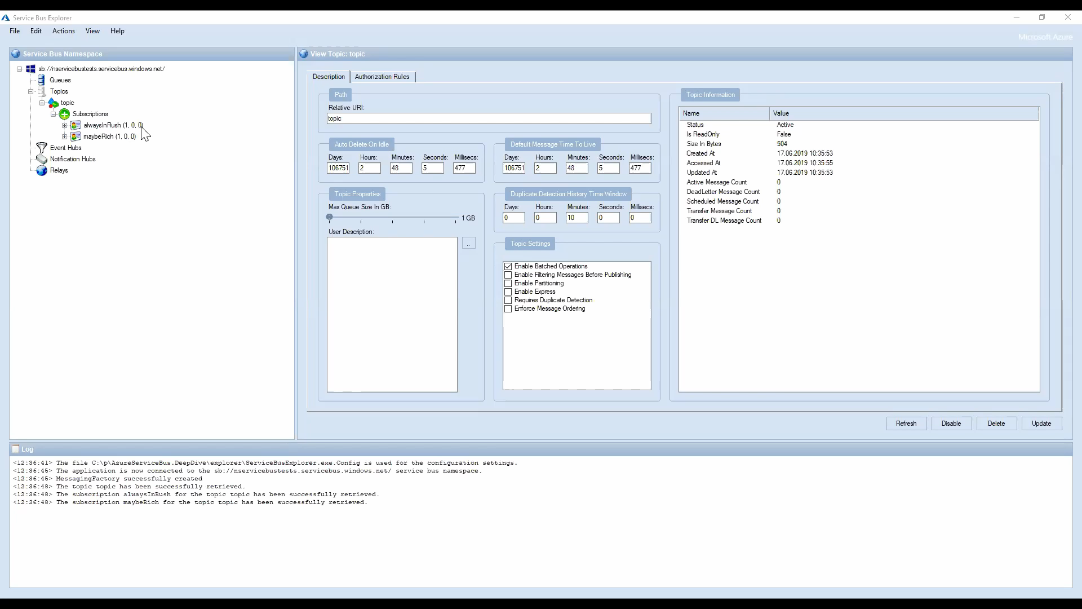
Notes:
Let’s check the alwaysInRush label

Slide 68
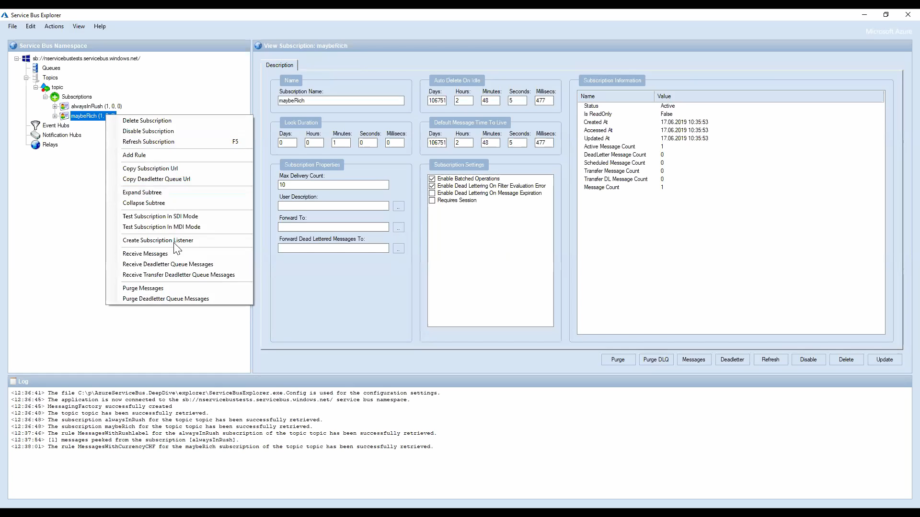
Notes:
NServiceBus uses SQL Rules to match the enclosed message type with a like SQL filter

Slide 69
Favor Correlation filter over SQL filter
Notes:
All filters evaluate message properties. Filters cannot evaluate the message body.
Complex filter rules require processing capacity. In particular, the use of SQL filter rules results in lower overall message throughput at the subscription, topic, and namespace level. Whenever possible, applications should choose correlation filters over SQL-like filters, since they are much more efficient in processing and therefore have less impact on throughput.

Slide 70
Subscriptions are virtual queues and subscribers need to receive from them
Notes:
Unless you combine pubsub with forwarding to create rich topologies!

Slide 71
Topologies
Notes:
So let’s see how we can combine Topics, Rules and Subscriptions together with forwarding.

Slide 72
topic
Rule
Rule
Subscription1
Subscription2
ForwardTo
ForwardTo
Queue
Notes:
So instead of receiving on every subscription we manage (and even if it is just one) we can configure forwarding on the subscriptions to forward messages into the input queue. While we pay an operation per forwarding in total this approach is still better because we have less moving parts to manage. For example with the subscriptions being virtual queues we would need to have an active receiver on every subscription and on the input queue plus manage the quotas, deadletter queues etc.

Slide 73
var subscriptionDescription = new CreateSubscriptionOptions(topicName, rushSubscription)
{
ForwardTo = inputQueue
};
await client.CreateSubscriptionAsync(subscriptionDescription);
subscriptionDescription =
new CreateSubscriptionOptions(topicName, currencySubscription)
{
ForwardTo = inputQueue
};
await client.CreateSubscriptionAsync(subscriptionDescription);
Notes:
Like before with a slight twist

Slide 74
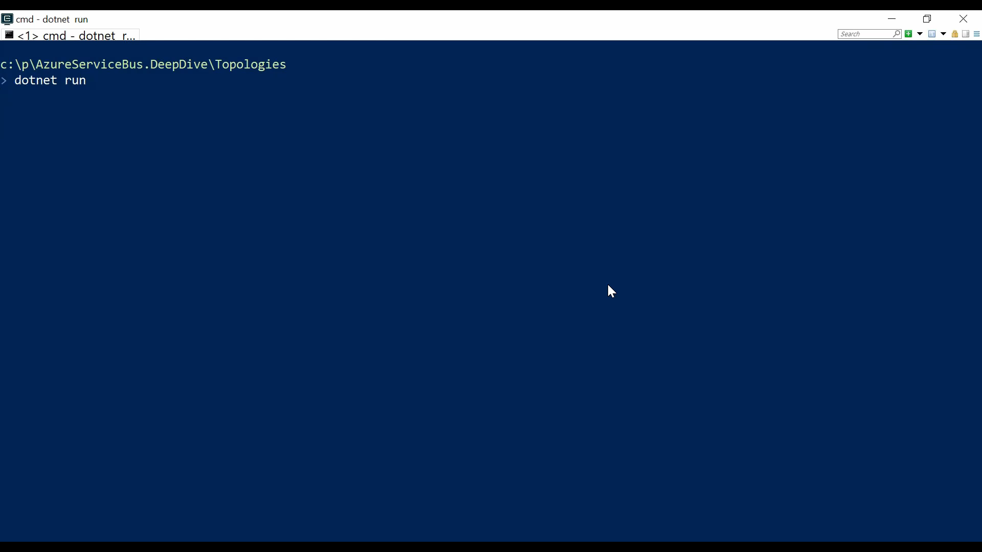
Notes:
Let’s run this. Very unspectacular. Things just arrive in the input queue :D
Let’s see how it looks like with the Service Bus Explorer

Slide 75
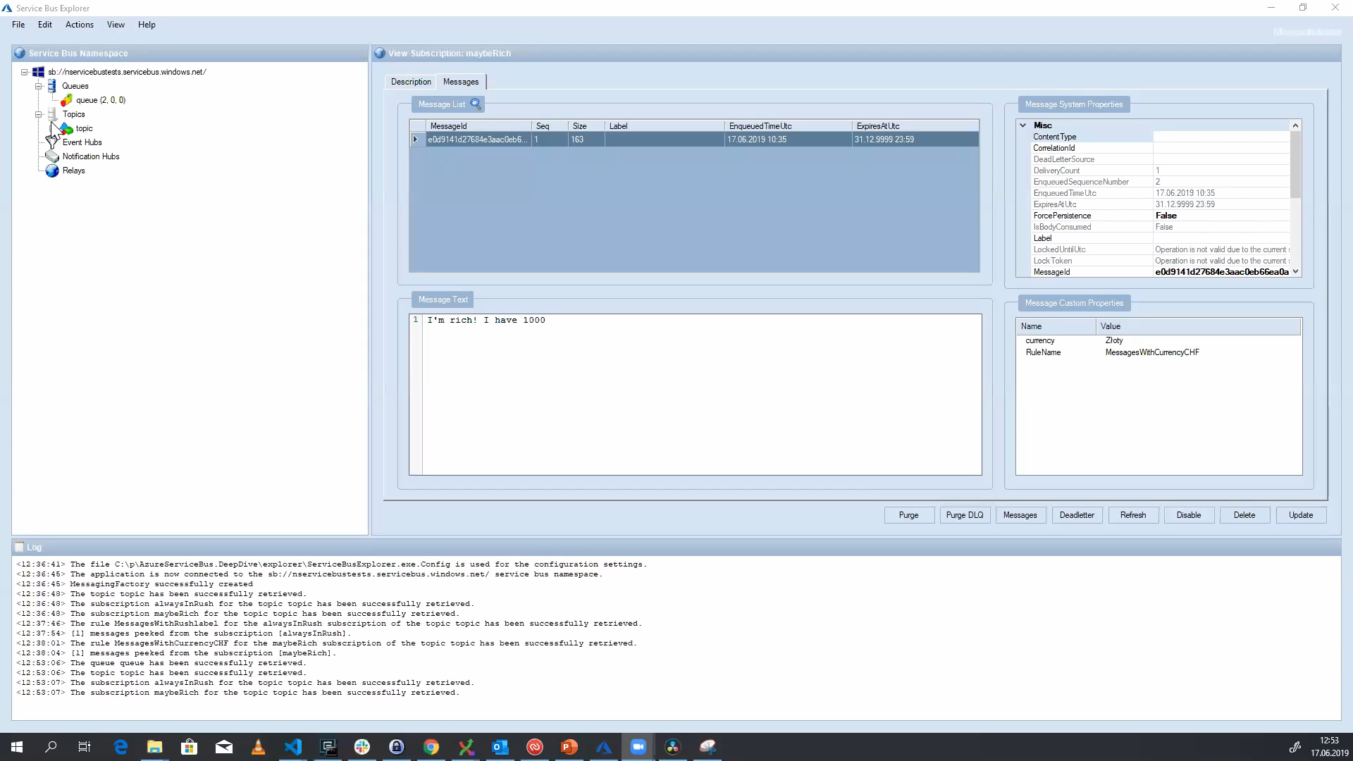
Notes:
Both subscriptions are empty and all the messages arrived in the input queue
Let’s have a quick look at the messages and see if the rule actions got still applied

Slide 76

Notes:
Indeed even my silly currency conversion still works

Slide 77
Atomic Sends
Notes:
Unlike a batch, we have a group of messages to send, but not all messages are available as at the same time.
We’d like to send messages in a transactional manner, ensuring that either all messages are sent successfully or they all rolled back

Slide 78
using (var scope = new TransactionScope(TransactionScopeAsyncFlowOption.Enabled))
{
var message = new ServiceBusMessage("Deep Dive 1");
await sender.SendMessageAsync(message);
message = new ServiceBusMessage("Deep Dive 2");
await sender.SendMessageAsync(message);
scope.Complete();
}
Notes:
We can simply wrap the Send operations within a transaction scope that has the async flow option enabled. The send operations will automatically enlist in that transaction scope.

Slide 79
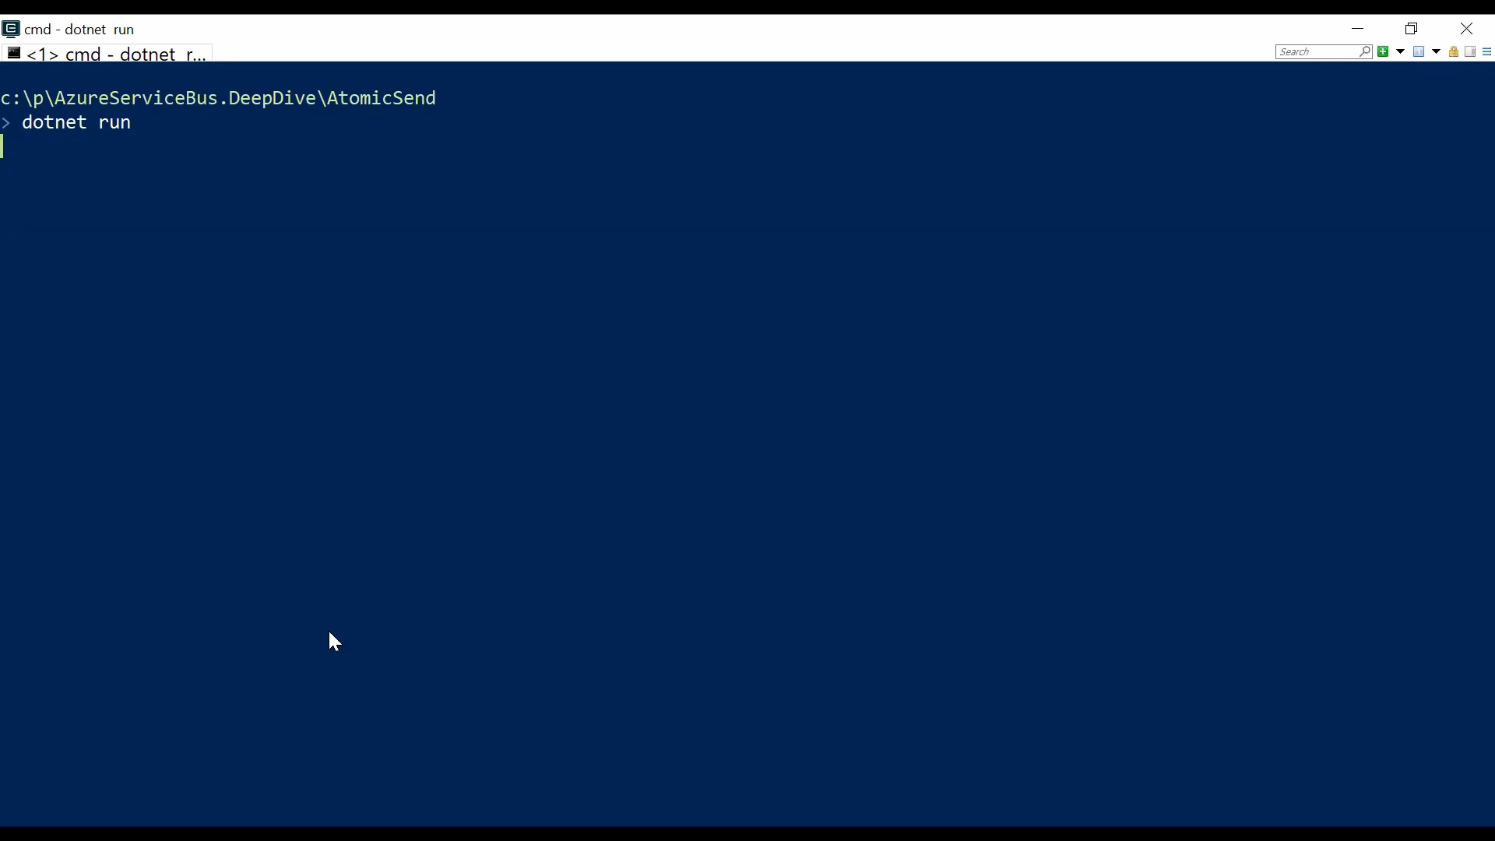
Transaction not
completed
Transaction completed
Notes:
During the first two send operations nothing is visible in the destination queue. Only after the transaction is completed things become visible

Slide 80
Batching
Notes:
Batching is a latency optimization technique and not a cost optimization technique
Let’s have a look what the latency to some of my closest datacenters is

Slide 81
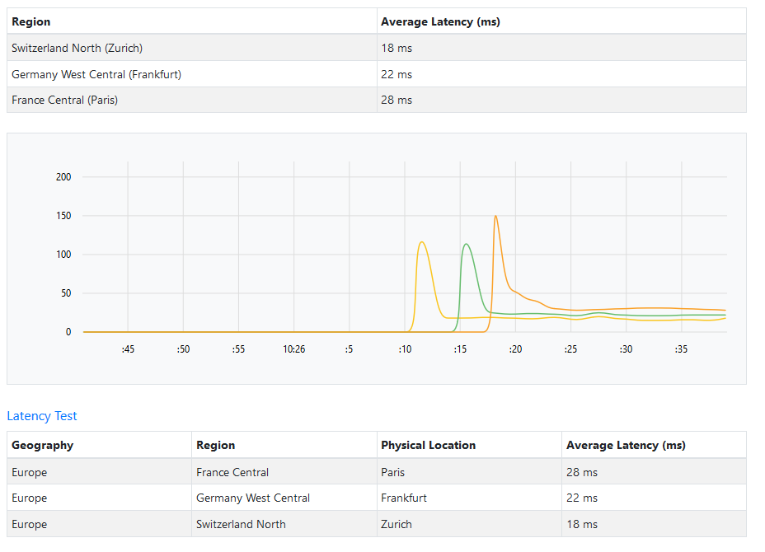
Notes:
20 ms average (although in real life averages are meaningless)
So effectively for every send takes 20 ms. When sending 10 messages it would take us 200 ms.
With batching we can send 10 messages with one call (although that one has slightly more data in it)
Let’s see how that works

Slide 82
var messages = new List<ServiceBusMessage>();
for (var i = 0; i < 10; i++)
{
var message = new ServiceBusMessage("Deep Dive{i}");
messages.Add(message);
}
await sender.SendMessagesAsync(messages);
Notes:
There are restrictions though

Slide 83
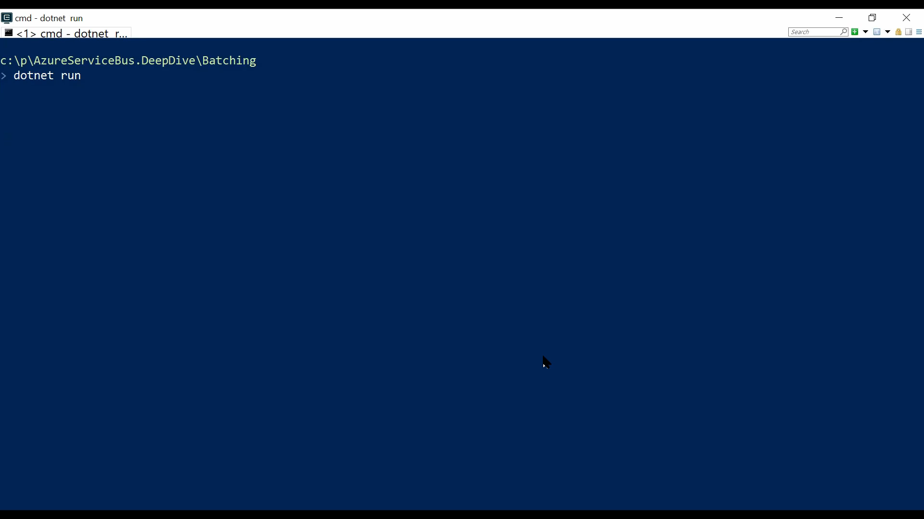
Notes:
The total batch size cannot exceed the maximum allowed message size on the tier
You cannot have more than 100 messages in an atomic batch (when using the atomic send approach I showed earlier)
If you don’t want to guess anymore use the dedicated batch API

Slide 84
var messagesToSend = new Queue<ServiceBusMessage>();
for (var i = 0; i < 4500; i++)
{
var message = new ServiceBusMessage($"Deep Dive{i}. Deep Dive{i}. Deep Dive{i}.");
messagesToSend.Enqueue(message);
}
Notes:
The number 4500 is deliberate. That is the total amount of messages you can send right now on the standard tier per batch even if the total message size is below the max message size. I’ve raised an issue about it and the team is discussing how to improve this situation in the SDK with information sent by the service bus itself. Stay tuned

Slide 85
var messageCount = messagesToSend.Count;
int batchCount = 1;
while (messagesToSend.Count > 0)
{
using ServiceBusMessageBatch messageBatch = await sender.CreateMessageBatchAsync();
if (messageBatch.TryAddMessage(messagesToSend.Peek()))
{
messagesToSend.Dequeue();
}
else
{
throw new Exception($"Message {messageCount - messagesToSend.Count} is too large and cannot be sent.");
}
while (messagesToSend.Count > 0 && messageBatch.TryAddMessage(messagesToSend.Peek()))
{
messagesToSend.Dequeue();
}
await sender.SendMessagesAsync(messageBatch);
}

Slide 86
Upgrade to premium tier
Use ServiceBus.AttachmentPlugin
Notes:
Use Attachment plugin to reduce messages size, caveat the new SDK doesn’t support plugins yet
Premium tier – bring a bigger gun, and who knows maybe the premium tier will one day allow even bigger messages ;)

Slide 87
Send Via
Notes:
In scenarios where a transactional processing is required for an incoming message that would generate some outgoing messages, the incoming and outgoing messages should all succeed or rollback. Failure to do so would either create duplicate processing (failure to complete the incoming message) or ghost messages (failure to revert the outgoing messages).

Slide 88
Incoming
Outgoing1
Transfer
Outgoing2
Notes:
Similar to shipping something from one point (source) to another point (destination), your package might go through straight to the destination and instead, might go through an intermediary.
The idea behind Send-via is to create an atomic operation between an incoming message and the outgoing messages.
It works with a SendVia header and a TransactionScope that only SDK operations are allowed to enlisten to (volatile enlistement).
Transport support enlisting outgoing operations in the current receive transaction. This prevents messages being sent to downstream endpoints during retries.
This mode has the same consistency guarantees as the PeekLock mode, but additionally it prevents occurrence of ghost messages since all outgoing operations are atomic with the ongoing receive operation.

Slide 89
await using var transactionalClient = new ServiceBusClient(connectionString,
new ServiceBusClientOptions
{
EnableCrossEntityTransactions = true,
});
receiver = transactionalClient.CreateProcessor(inputQueue);
sender = transactionalClient.CreateSender(destinationQueue);

Slide 90
receiver.ProcessMessageAsync += async processMessageEventArgs =>
{
var message = processMessageEventArgs.Message;
using (var scope = new TransactionScope(TransactionScopeAsyncFlowOption.Enabled))
{
await sender.SendMessageAsync(new ServiceBusMessage("Will not leak"));
if (!message.ApplicationProperties.ContainsKey("Win"))
throw new InvalidOperationException();
await sender.SendMessageAsync(new ServiceBusMessage("Will not leak"));
scope.Complete();
}
};

Slide 91
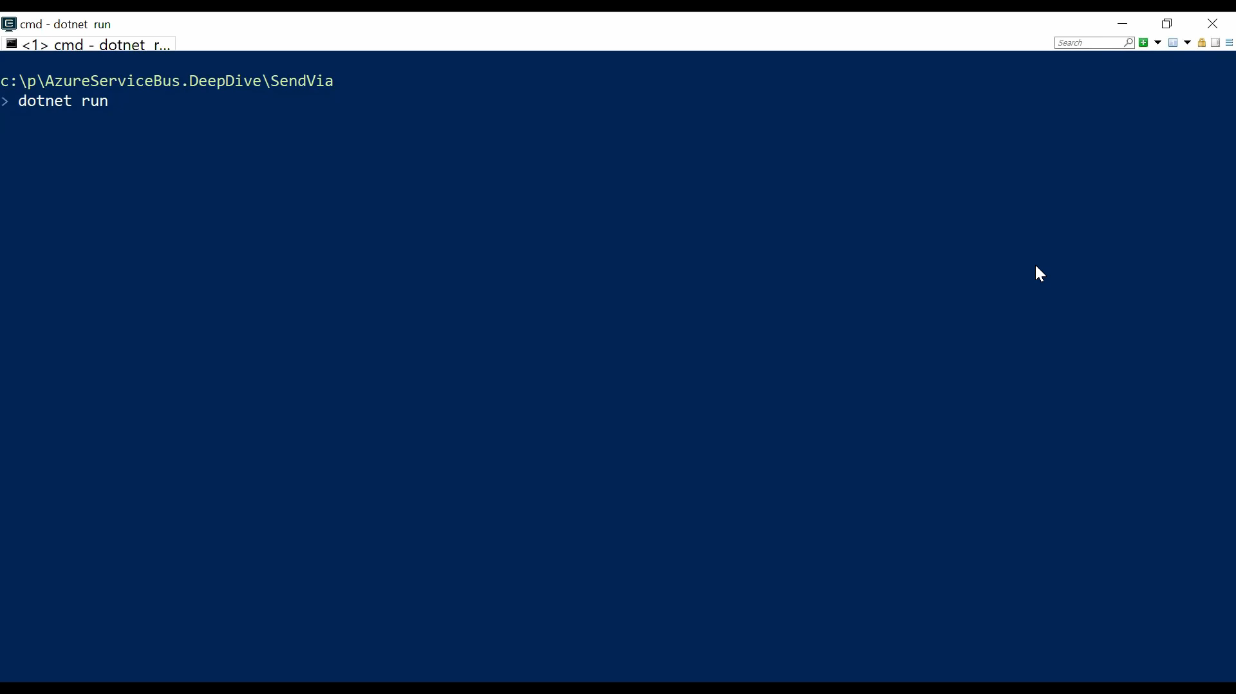

Slide 92
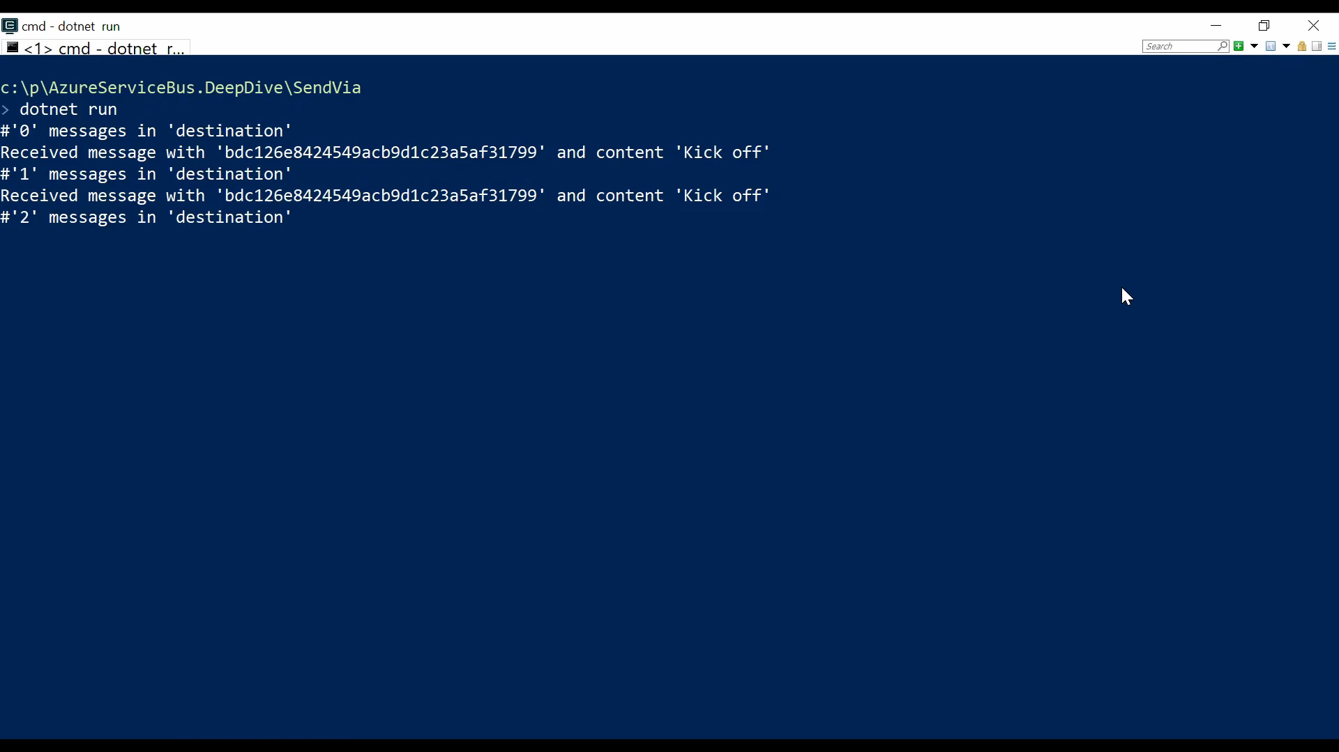
Notes:
First send messages within receive without TX Scope

Slide 93
TransferDLQ
Notes:
Reasons for deadlettering
Exceeded TimeToLive
Exceeded MaxDeliveryCount
Errors while processing subscription rules when CreateSubscriptionOption.DeadLetteringOnFilterEvaluationExceptions is set
Every queue has essentially 4 queues
queue
queue/$DeadLetterQueue
queue/$Transfer
queue/$Transfer/$DeadLetterQueue

Slide 94
receiver.ProcessMessageAsync += async processMessageEventArgs =>
{
var message = processMessageEventArgs.Message; using (var scope = new TransactionScope(TransactionScopeAsyncFlowOption.Enabled))
{
await sender.SendMessageAsync(new ServiceBusMessage("Will not leak"));
var client = new ServiceBusAdministrationClient(connectionString);
QueueProperties queueProperties = await client.GetQueueAsync(destinationQueue);
queueProperties.Status = EntityStatus.SendDisabled;
await client.UpdateQueueAsync(queueProperties);
scope.Complete();
}
};

Slide 95
var client = new ServiceBusAdministrationClient(connectionString);
QueueRuntimeProperties info = await client
.GetQueueRuntimeInfoAsync(destination);
long activeMessageCount = info.ActiveMessageCount;
long deadLetterMessageCount = info.DeadLetterMessageCount;
long transferDeadLetterMessageCount = info.TransferDeadLetterMessageCount;
string destinationDeadLetterPath = EntityNameHelper
.FormatDeadLetterPath(destination);
string destinationTransferDeadLetterPath = EntityNameHelper
.FormatTransferDeadLetterPath(destination);

Slide 96
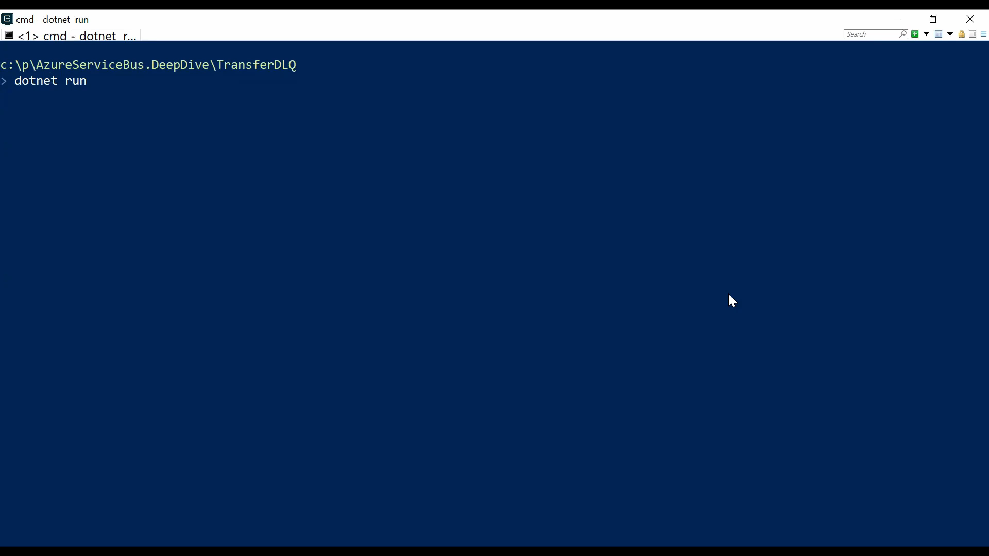

Slide 97
Sessions
Notes:
A session acts in many ways like a sub queue.
Sessions provide concurrent de-multiplexing of interleaved message streams while preserving and guaranteeing ordered delivery.

Slide 98
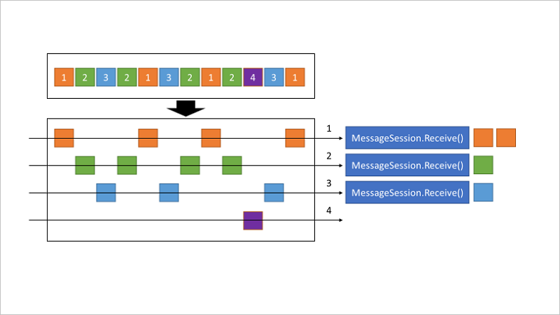
Notes:
When the MessageSession object is accepted and while it is held by a client, that client holds an exclusive lock on all messages with that session's SessionId that exist in the queue or subscription, and also on all messages with that SessionId that still arrive while the session is held.
The lock is released when Close or CloseAsync are called, or when the lock expires in cases in which the application is unable to perform the close operation. The session lock should be treated like an exclusive lock on a file, meaning that the application should close the session as soon as it no longer needs it and/or does not expect any further messages.
When multiple concurrent receivers pull from the queue, the messages belonging to a particular session are dispatched to the specific receiver that currently holds the lock for that session. With that operation, an interleaved message stream residing in one queue or subscription is cleanly de-multiplexed to different receivers and those receivers can also live on different client machines, since the lock management happens service-side, inside Service Bus.
The previous illustration shows three concurrent session receivers. One Session with SessionId = 4 has no active, owning client, which means that no messages are delivered from this specific session. A session acts in many ways like a sub queue.
The session lock held by the session receiver is an umbrella for the message locks used by the peek-lock settlement mode. A receiver cannot have two messages concurrently "in flight," but the messages must be processed in order. A new message can only be obtained when the prior message has been completed or dead-lettered. Abandoning a message causes the same message to be served again with the next receive operation.
Session state is - limited to the maximum message size

Slide 99
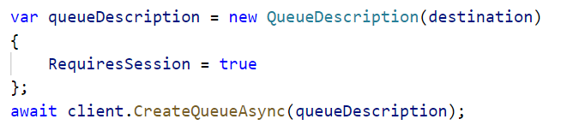

Slide 100
var messages = new List<ServiceBusMessage>
{
new ServiceBusMessage("Orange 1") {SessionId = "Orange"},
new ServiceBusMessage("Green 1") {SessionId = "Green"},
new ServiceBusMessage("Blue 1") {SessionId = "Blue"},
new ServiceBusMessage("Green 2") {SessionId = "Green"},
new ServiceBusMessage("Orange 2") {SessionId = "Orange"},
new ServiceBusMessage("Blue 2") {SessionId = "Blue"},
new ServiceBusMessage("Green 3") {SessionId = "Green"},
new ServiceBusMessage("Orange 3") {SessionId = "Orange"},
new ServiceBusMessage("Green 4") {SessionId = "Green"},
new ServiceBusMessage("Purple 1") {SessionId = "Purple"},
new ServiceBusMessage("Blue 3") {SessionId = "Blue"},
new ServiceBusMessage("Orange 4") {SessionId = "Orange"}
};

Slide 101
await using var receiver = serviceBusClient
.CreateSessionProcessor(destination, new ServiceBusSessionProcessorOptions
{
AutoCompleteMessages = true,
MaxConcurrentSessions = 1,
MaxAutoLockRenewalDuration = TimeSpan.FromMinutes(10),
SessionIdleTimeout = TimeSpan.FromSeconds(2)
});
receiver.ProcessMessageAsync += async processMessageEventArgs =>
{
var message = processMessageEventArgs.Message;
await Error.WriteLineAsync(
$"Received message on session '{processMessageEventArgs.SessionId}’
with '{message.MessageId}' and content '{Encoding.UTF8.GetString(message.Body)}'");
};
await receiver.StartProcessingAsync();

Slide 102
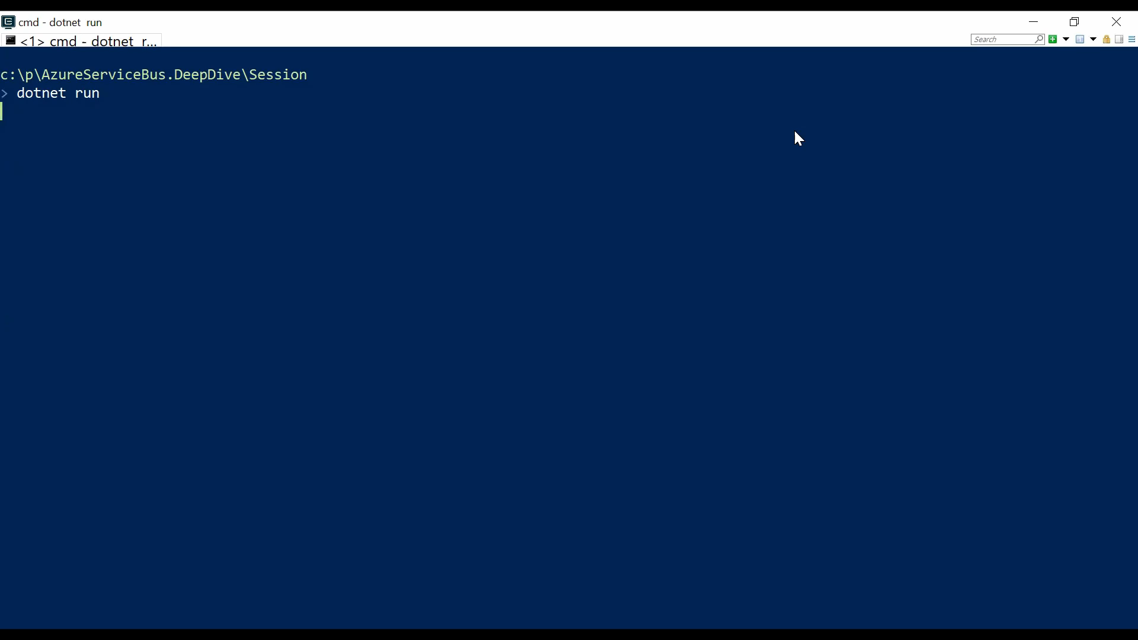

Slide 103
Dedup
Notes:
Duplicate detection takes the doubt out of these situations by enabling the sender resend the same message, and the queue or topic discards any duplicate copies. For application controlled message ids
The duplicate detection time history defaults to 30 seconds for queues and topics, with a maximum value of seven days.
Enabling duplicate detection and the size of the window directly impact the queue (and topic) throughput, since all recorded message-ids must be matched against the newly submitted message identifier.
Keeping the window small means that fewer message-ids must be retained and matched, and throughput is impacted less. For high throughput entities that require duplicate detection, you should keep the window as small as possible.

Slide 104
var queueDescription = new CreateQueueOptions(destination)
{
RequiresDuplicateDetection = true,
DuplicateDetectionHistoryTimeWindow = TimeSpan.FromSeconds(20)
};
await client.CreateQueueAsync(queueDescription);

Slide 105
var content = Encoding.UTF8.GetBytes("Message1Message1");
var messageId = new Guid(content).ToString();
var messages = new List<ServiceBusMessage>
{
new ServiceBusMessage(content) { MessageId = messageId },
new ServiceBusMessage(content) { MessageId = messageId },
new ServiceBusMessage(content) { MessageId = messageId }
};
await sender.SendMessagesAsync(messages);

Slide 106
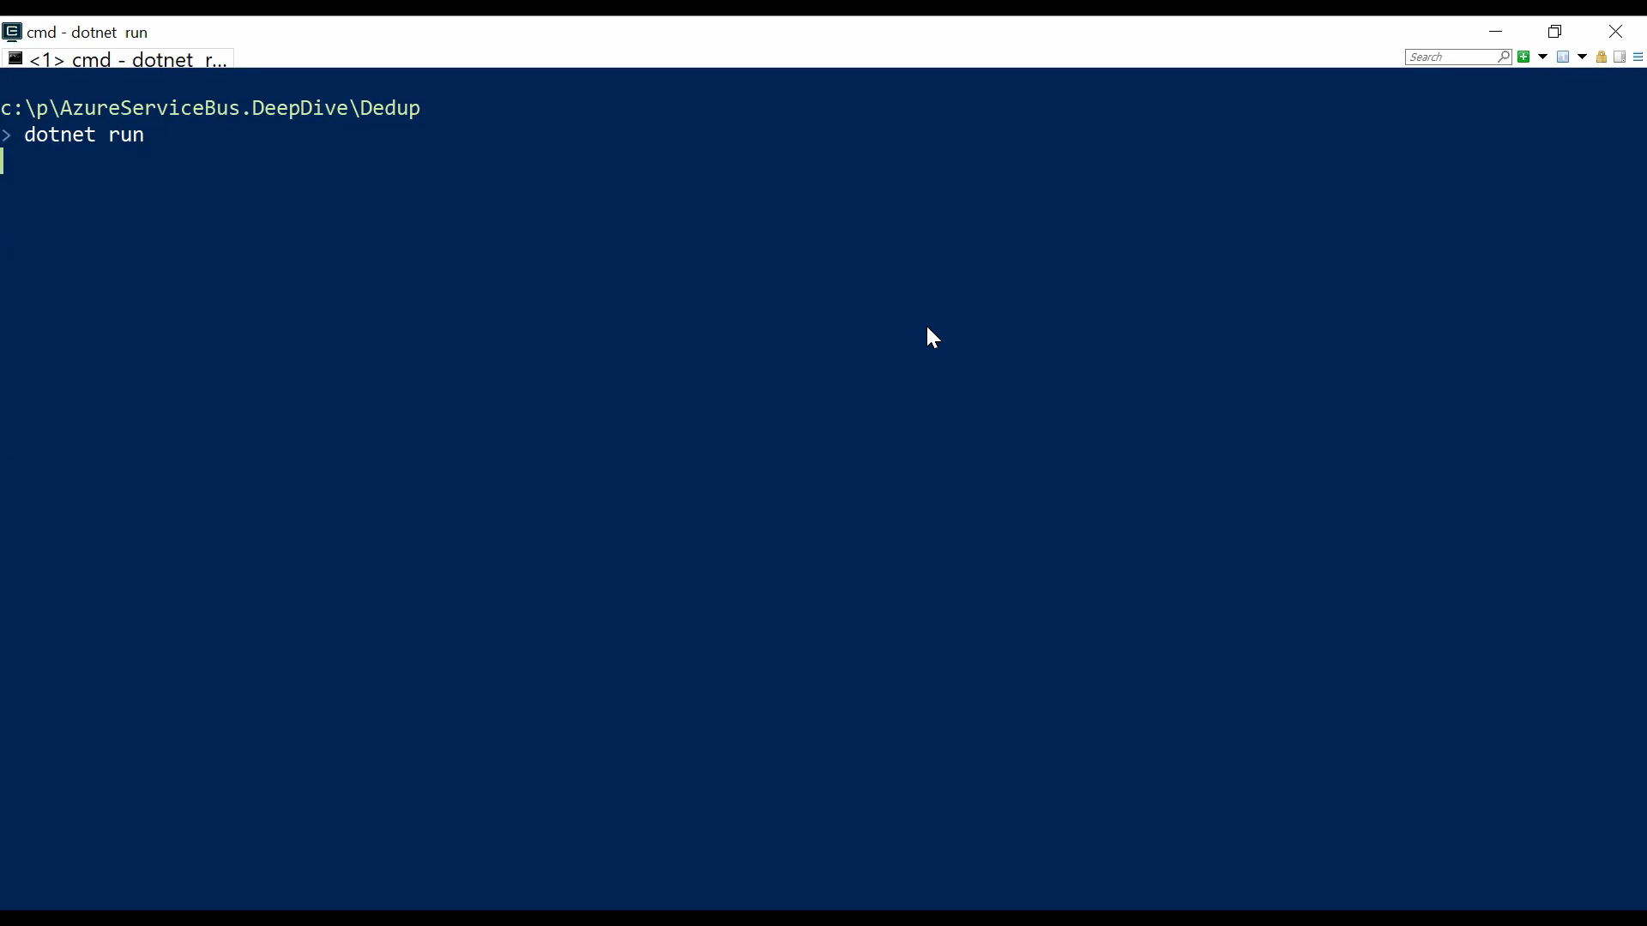

Slide 107


Notes:
Serverless360 –management, monitoring, and troubleshooting
SBExplorer
Aside from the predictable throughput and dedicated resources, there are some advanced features that are only available to the premium tier club members
VNET support
GeoDR
Azure Zones
EventGrid integration
Dedicated resources
Predictable throughput
1MB message size
Vs
Lower budget requirement
Multiple namespaces
Decent message size
Gets the job done

Slide 108
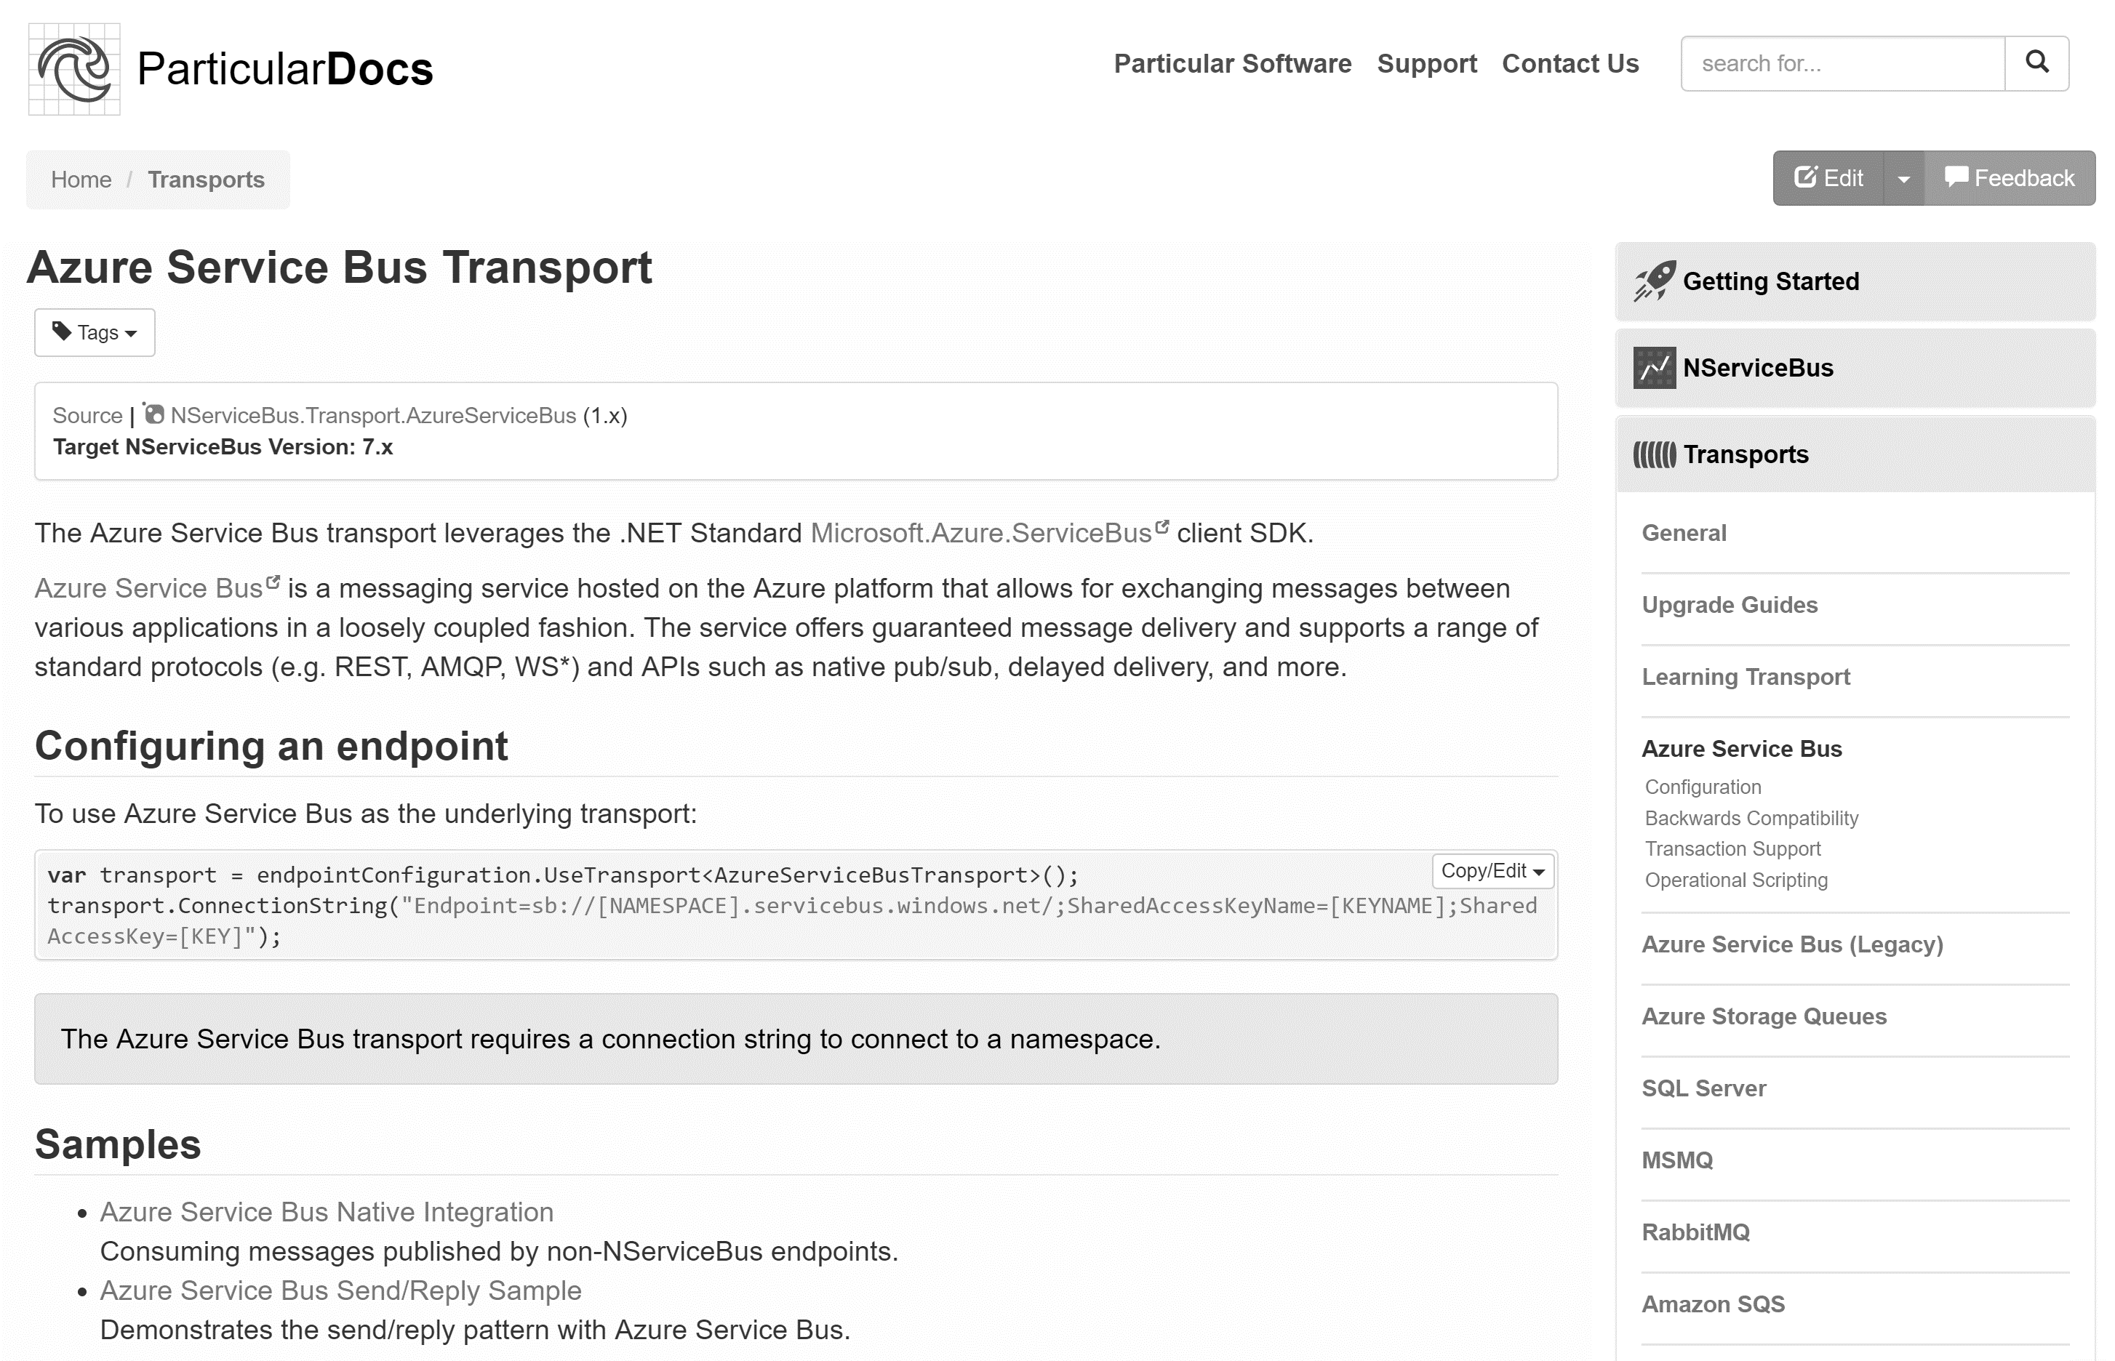
go.particular.net/sample

Slide 109
Thanks
Notes:
Thanks

Slide 110
Slides, Links…
github.com/danielmarbach/AzureServiceBus.DeepDive

Slide 111
Q & A

Slide 112

Software Engineer
Microsoft MVP
@danielmarbach
particular.net/blog
planetgeek.ch

